Slide 1
Ch8: Artificial Neural networks Artificial Neural networks
Introduction to Back Propagation Neural Networks BPNN
By KH Wong

Slide 2
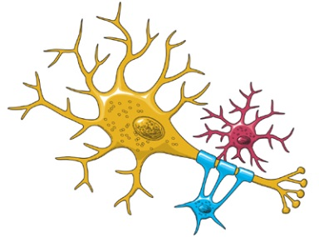
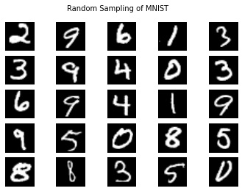
Introduction
Neural Network research is very popular
A high performance Classifier (multi-class)
Successful in handwritten optical character OCR recognition, speech recognition, image noise removal etc.
Easy to implement
Slow in learning
Fast in classification
Example and dataset:
http://yann.lecun.com/exdb/mnist/

Slide 3
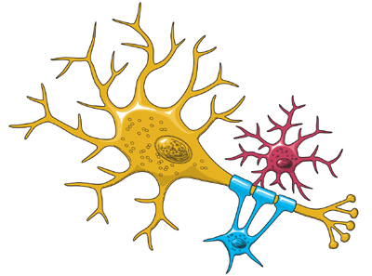
Motivation
Biological findings inspire the development of Neural Net
Input →weights →Logic function→ output
Biological relation
Input
Dendrites
Output
Human computes using a net
Neuron(Logic function)
X=inputs
W=weights
Output
https://www.ninds.nih.gov/Disorders/Patient-Caregiver-Education/Life-and-Death-Neuron

Slide 4

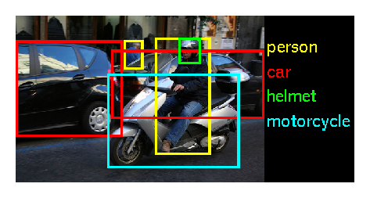
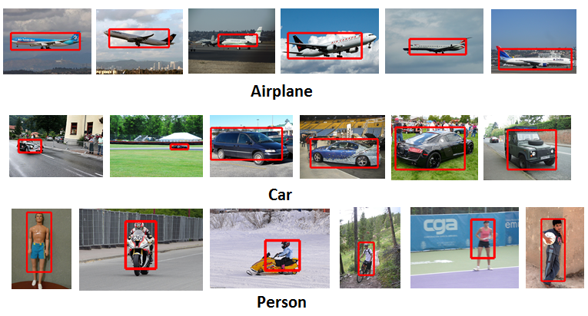
Applications
Microsoft: XiaoIce. AI
http://image-net.org/challenges/LSVRC/2015/
200 categories: accordion, airplane ,ant ,antelope ….dishwasher ,dog ,domestic cat ,dragonfly ,drum ,dumbbell , etc.
Tensor flow
 |  | ILSVRC 2015
Number of object classes |  | 200
Training | Num images | 456567
 | Num objects | 478807
Validation | Num images | 20121
 | Num objects | 55502
Testing | Num images | 40152
 | Num objects | ---

Slide 5
Different types of artificial neural networks
Autoencoder
DNN Deep neural network & Deep learning
MLP Multilayer perceptron
RNN (Recurrent Neural Networks), LSTM (Long Short-term memory)
RBM Restricted Boltzmann machine
SOM (Self-organizing map)
Convolutional neural network CNN
From https://en.wikipedia.org/wiki/Artificial_neural_network
The method discussed in this power point can be applied to many of the above nets.

Slide 6
Theory of Back Propagation Neural Net (BPNN)
Use many samples to train the weights (W) & Biases (b), so it can be used to classify an unknown input into different classes
Will explain
How to use it after training: forward pass (classify /or the recognition of the input )
How to train it: how to train the weights and biases (using forward and backward passes)

Slide 7
Back propagation is an essential step in many artificial network designs
Used to train an artificial neural network
For each training example x_{i}, a supervised (teacher) output t_{i} is given.
For each i^{th} training sample x: x_{i}
Feed forward propagation: feed x_{i} to the neural net, obtain output y_{i}. Error e_{i} ∝|t_{i}-y_{i}|²
Back propagation: feed e_{i} back to net from the output side and adjust weight w (by finding ∆w) to minimize e.
Repeat 1) and 2) for all samples until E is 0 or very small.

Slide 8
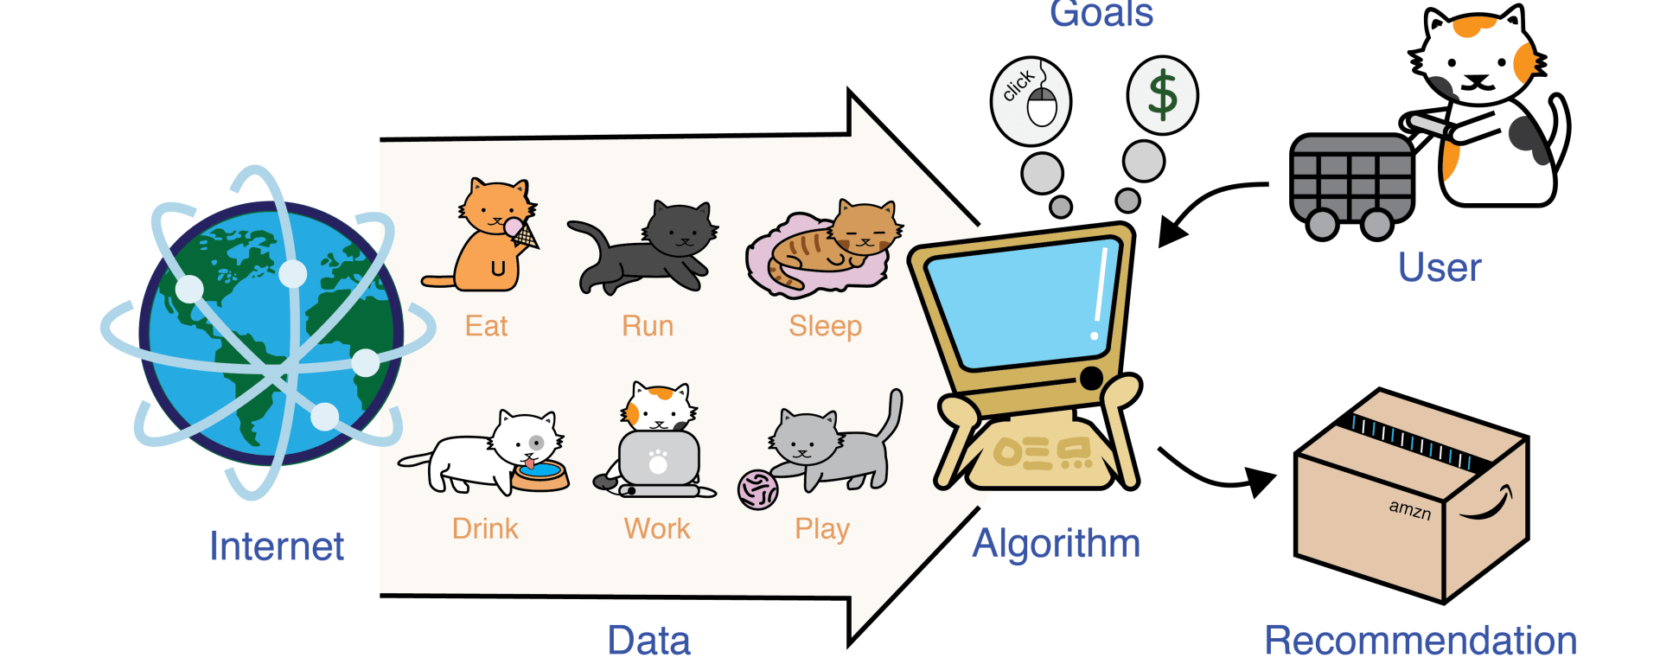
Concept of supervised learning
Collect data (e.g. from Internet)
Use Algorithm to learn the features
User can set up goals and the algorithm gives you the recommendation
This Photo by Unknown Author is licensed under CC BY-SA-NC

Slide 9
Example :Optical character recognition OCR
Training: Train the system first by presenting a lot of samples with known classes to the network
Recognition: When an image is input to the system, it will tell what character it is
Training up the network:
weights (W) and bias (b)
Neural Net
Neural Net
Output3=‘1’, other outputs=‘0’

Slide 10


Overview of what we will learn
Back Propagation Neural Networks (BPNN)
Part 1: Feed forward processing (classification or Recognition)
Part 2: Back propagation (Training the network), also include forward processing, backward processing and update weights
Appendix:
A MATLAB example is explained
%source : http://www.mathworks.com/matlabcentral/fileexchange/19997-neural-network-for-pattern-recognition-tutorial

Slide 11
Part 1 (classification in action /or the Recognition process)
Forward pass of Back Propagation Neural Net (BPNN)
Assume weights (W) and bias (b) are found by training already (to be discussed in part2)

Slide 12
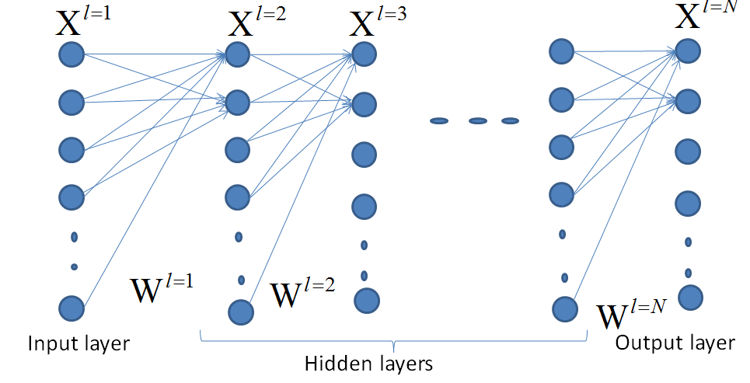
Recognition: assume weight (W) bias (b) are found earlier
Output
Output(0)=0
Output(1)=0
Output(2)=0
Output(3)=1
:
Output(9)=0
Assume you
have classes(0-9)
Each pixel is X(u,v)
Correct recognition

Slide 13
A neural network
Input layer
Output layer
Hidden layers
Blue circles are neurons (X), they form layers.
The links (lines) are weights (W).
There are : Input layer, hidden layers, and output layer.

Slide 14
Exercise 1
How many inputs, and output neurons?
Ans:
How many hidden layers that this network have?
Ans:
How many weights in total?
Ans:
How do you call this layer of neurons X ?
Ans:
Inputs
neurons

Slide 15
ANSWER: Exercise 1
How many inputs and output neurons?
Ans: 4 input and 2 output neurons
How many hidden layers that this network have?
Ans: 3
How many weights in total?
Ans: First hidden layer has 4x4, second layer has 3x4, third hidden layer has 3x3, fourth hidden layer to output layer has 2x3 weights. total=16+12+9+6=43
How do you call this layer of neurons X ?
Ans:
Inputs
neurons

Slide 16
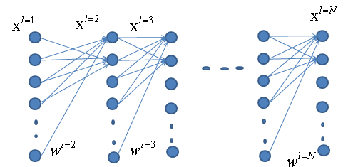
Multi-layer structure of a BP neural network
Input
layer
Other
hidden
layers

Slide 17
Inside each neuron there is a bias (b)
In between any 2 neighboring neuron layers, a set of weights are found

Slide 18
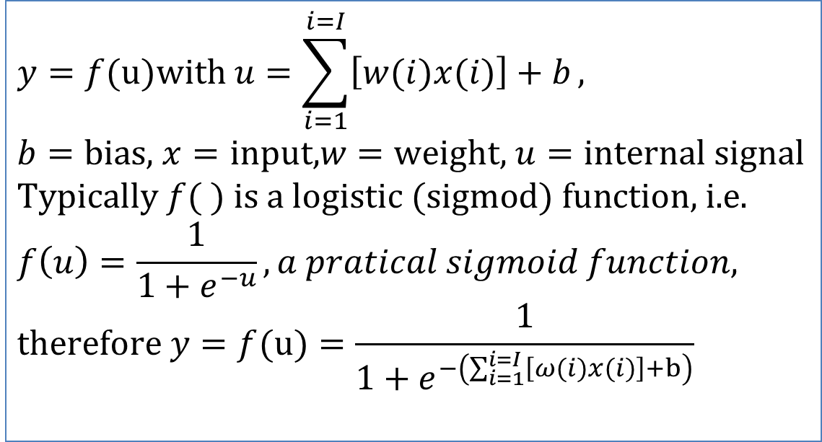
Inside each neuron x=input, y=output
$$y=f(u)\text{with} u=\sum_{i=1}^{i=I}{\left[w(i)x(i)\right]+b}, \\ b=\text{bias}\text{, }x=\text{input}\text{,}w=\text{weight}\text{, }u=\text{internal} \text{signal} \\ \text{Typically} f( ) \text{is} \text{a} \text{logistic} (\text{sigmod}) \text{function}\text{, }\text{i}\text{.}\text{e}\text{.} \\ f\left(u\right)=\frac{1}{1+e^{−u}},a pratical sigmoid function, \\ \text{therefore} y=f(u)=\frac{1}{1+e^{−\left(\sum_{i=1}^{i=I}{\left[ω(i)x(i)\right]+b}\right)}}$$
Notes:
%%%%%%%%%%%%%%%%%%%%%%%%%%%%%%%%%%%%
\subsection{slide 17: model: Inside each neuron x=input, y=output}
$y=f(u) with u=\sum\limits_{i=1}^{i=I}[w(i)x(i)]+b,$\\
$b$=bias, $x$=input, $w$=weight, $u$=internal signal\\
Typically $f()$ is a logistic (Sigmod) function,i.e.\\
%
$f(u)=\frac{1}{1+exp{(-\beta u)}}$, assume $\beta=1$ for simplicity,\\
%
therefore $f(u)=\frac{1}{1+exp{
\big(- \sum\limits_{i=1}^{i=I}[w(i)x(i)]+b)
\big)}}$

Slide 19
Some good math videos on the web
https://www.youtube.com/watch?v=MzI1sppnqqY differentiation https://www.youtube.com/watch?v=BcOPKQAZcn0 Simple differentiation
https://www.youtube.com/watch?v=WjJ-kpgps1c Understand Calculus in 10 Minutes
https://www.youtube.com/watch?v=oo1ZZlvT2LQ On Exponential function
https://www.youtube.com/watch?v=rnoToCoEK48 Partial Differentiation

Slide 20
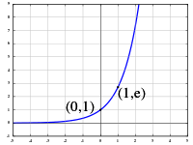
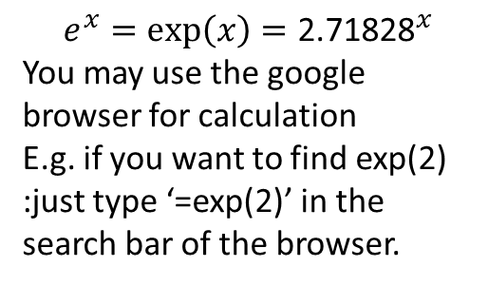
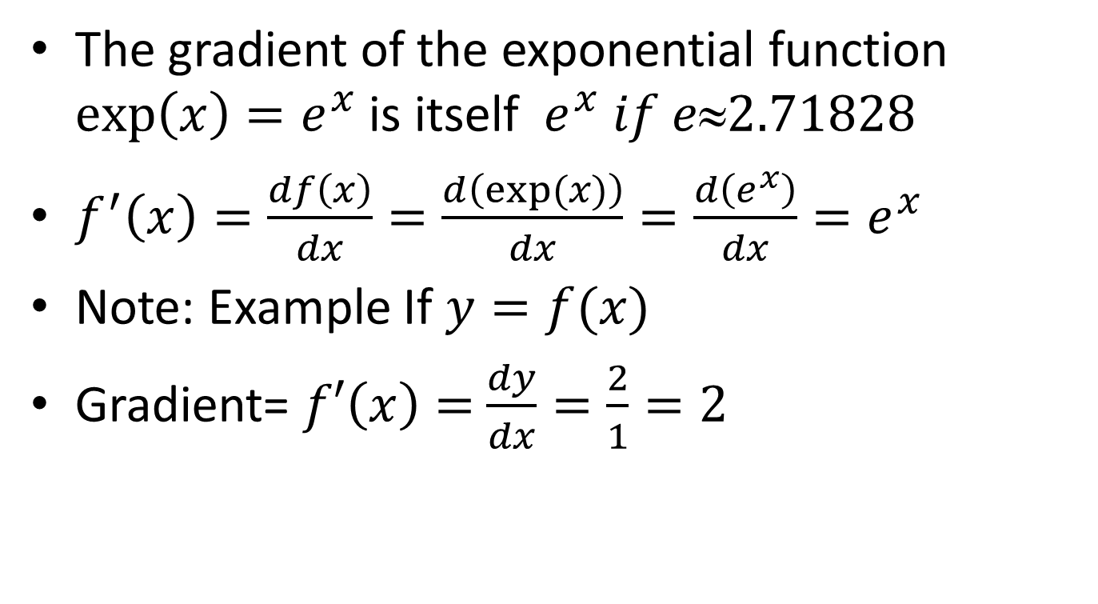
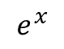
Essential result you must remember
The gradient of the exponential function $exp\left(x\right)=e^{x}$ is itself $e^{x} if e2.71828$
$f^{′}\left(x\right)=\frac{df\left(x\right)}{dx}=\frac{d\left(exp⁡(x)\right)}{dx}=\frac{d\left(e^{x}\right)}{dx}=e^{x}$
Note: Example If $y=f(x)$
Gradient= $f′\left(x\right)=$ $\frac{dy}{dx}=\frac{2}{1}=2$
$$e^{x}$$
x
$$e^{x}=\exp\left(x\right)={\text{2.71828}}^{x}$$
You may use the google browser for calculation
E.g. if you want to find exp(2)
:just type ‘=exp(2)’ in the search bar of the browser.
$$dy=2 meters$$
$$dx=1 meter$$

Slide 21
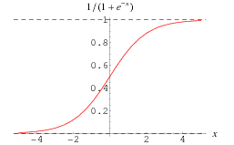
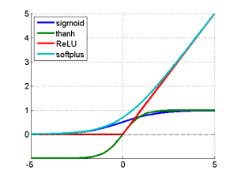
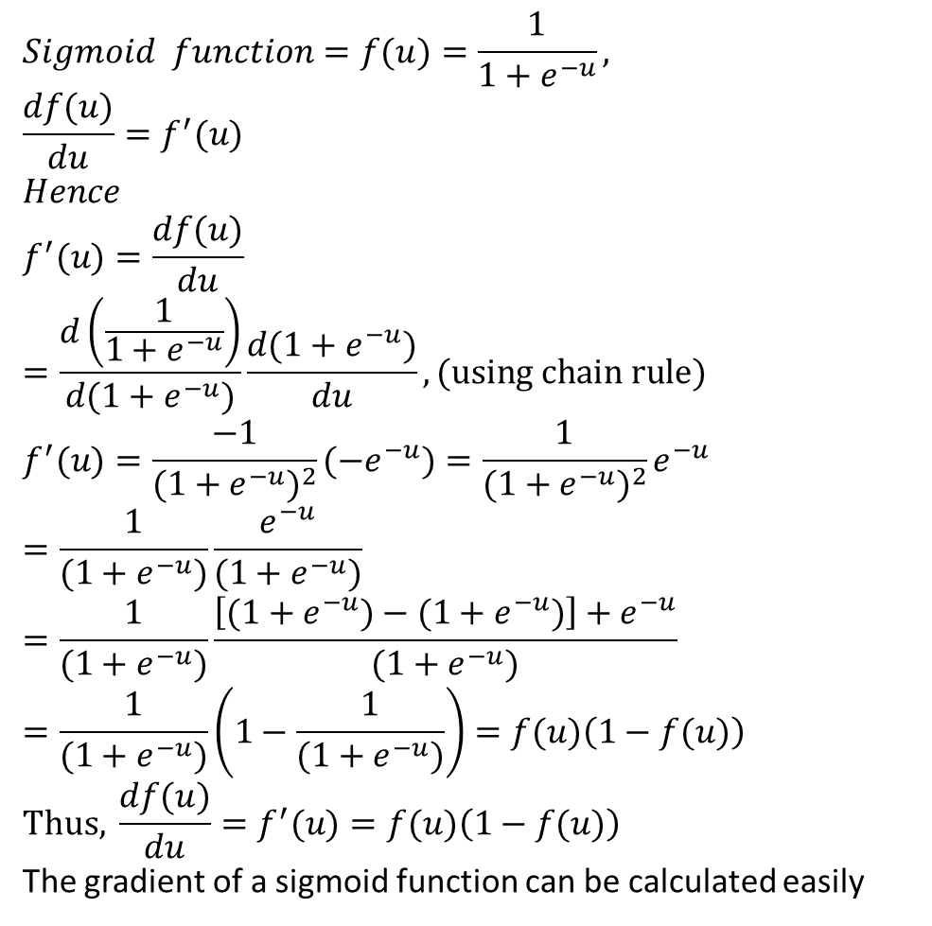
MATH STUFF: Sigmoid function f(u)= logsig(u) and its derivative f’(u)=dlogsig(u)
$$Sigmoid function=f(u)=\frac{1}{1+e^{−u}}, \\ \frac{df(u)}{du}=f^{′}(u) \\ Hence \\ f^{′}(u)=\frac{df(u)}{du}=\frac{d\left(\frac{1}{1+e^{−u}}\right)}{d(1+e^{−u})}\frac{d(1+e^{−u})}{du},(\text{using} \text{chain} \text{rule}) \\ f^{′}(u)=\frac{−1}{(1+e^{−u})^{2}}(−e^{−u})=\frac{1}{(1+e^{−u})^{2}}e^{−u} \\ =\frac{1}{(1+e^{−u})}\frac{e^{−u}}{(1+e^{−u})}=\frac{1}{(1+e^{−u})}\frac{\left[(1+e^{−u})−(1+e^{−u})\right]+e^{−u}}{(1+e^{−u})} \\ =\frac{1}{(1+e^{−u})}\left(1−\frac{1}{(1+e^{−u})}\right)=f(u)\left(1−f(u)\right) \\ \text{Thus}\text{, }\frac{df(u)}{du}=f^{′}(u)=f(u)\left(1−f(u)\right)$$
The gradient of a sigmoid function can be calculated easily
http://mathworld.wolfram.com/SigmoidFunction.html
Logistic sigmoid (logsig)
https://kawahara.ca/how-to-compute-the-derivative-of-a-sigmoid-function-fully-worked-example/
http://link.springer.com/chapter/10.1007%2F3-540-59497-3_175#page-1 , https://imiloainf.wordpress.com/2013/11/06/rectifier-nonlinearities/
Notes:
%%%%%%%%%%%%%%%%%%%%%%%%%%%%%%%%%%%%
\subsection{slide 18: Sigmoid function $f(u)= logsig(u)$ and its derivative $f’(u)=dlogsig(u)$}
$f(u)=\frac{1}{1+e^{-\beta u}}=\frac{1}{1+e^{- u}}$, for simplicity set $\beta =1$\\
%
$d \frac{ f(u)}{du}=f(u)$\\
Note $\frac{de^x}{dx}=e^x$\\
$f'(u)=\frac{d f(u)}{du}=
\frac{
d(\frac{1}{1+e^{-u}})
}
{d(1+e^{-u})}
%
\frac{d(1+e^{-u})}{du}
$, (using chain rule)\\
%%%%%%%
$f'(u)=\frac{-1}{(1+e^{-u})}
(-e^{-u})$
%
$=\frac{1}{(1+d^{-u})^2}
e^{-u}$\\
%%%%%%%%%%%%%
$=\frac{1}{(1+e^{-u})}
\frac{e^{-u}}{(1+e^{-u})}
%%
=\frac{1}{(1+e^{-u})}
\frac{[(1+e^{-u})-(1+e^{-u})]+e^{-u}}
{(1+e^{-u})}
$\\
%%%%%%%%%%%%%%
$=\frac{1}{(1+e^{-u})}
(1-\frac{1}{(1+e^{-u})})
=f(u)(1-f(u))
$\\
This, $\frac{ d f(u)}{du}=f'(u)=f(u)(1-f(u))$

Slide 22
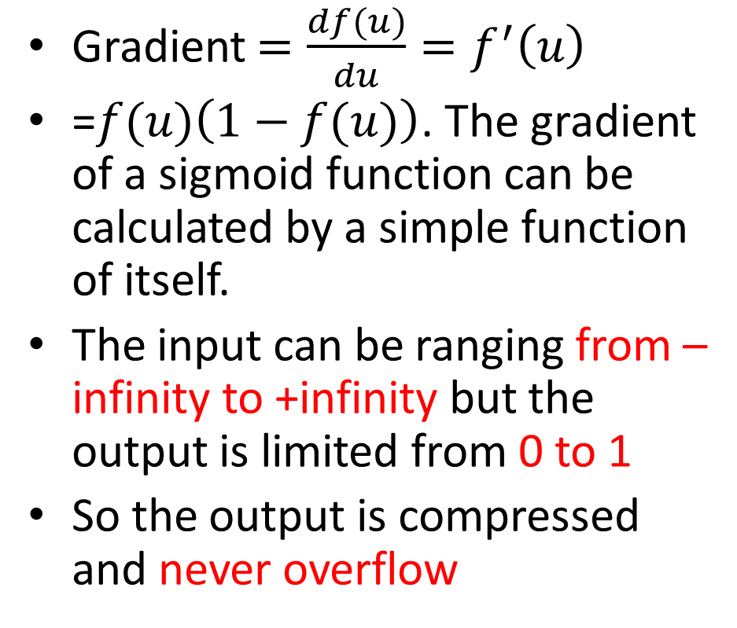

Why use sigmoid function
$$f(u)=\frac{1}{1+e^{−u}}$$
Gradient $=\frac{df(u)}{du}=f^{′}\left(u\right)$
=$f(u)\left(1−f(u)\right)$. The gradient of a sigmoid function can be calculated by a simple function of itself.
The input can be ranging from –infinity to +infinity but the output is limited from 0 to 1
So the output is compressed and never overflow
The idea:
Th input (excitement) range be large
(–infinity to +infinity )
Output
(0->1)
Never overflow
A neuron

Slide 23
Back Propagation Neural Net (BPNN) Forward pass
Forward pass is to find the output when an input is given. For example:
Assume we have used N=60,000 images (MNIST database) to train a network to recognize c=10 numerals.
When an unknown image is given to the input, the output neuron corresponds to the correct answer will give the highest output level.
0
0
0
1
0
0
Input
image
10 output neurons for 0,1,2,..,9

Slide 24
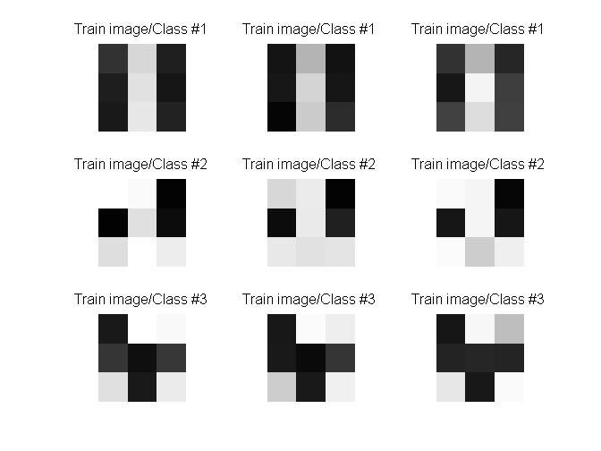

Our simple demo program
Training pattern
3 classes (in 3 rows)
Each class has 3 training samples (items in each row)
After training , an input (assume it is test image #2) is presented to the network, the network should tell you it is class 2, etc.
class1
class2
class3
Result
:image (class 2)
Unknown
input

Slide 25
Numerical Example : Architecture of our example (see code in appendix)
Input
Layer
9x1 pixels
output
Layer 3x1

Slide 26
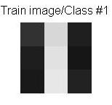
The input x
P2=[50 30 25 215 225 231 31 22 34; ... %class1: 1st training sample. Gray level 0->255
P1=50
P2=30
P3=25
P4=215
P5=225
P6=235
P7=31
P8=22
P9=34
9 neurons
In input layer
5 neurons
In hidden layer
3 neurons
In output layer

Slide 27
Exercise 2: Feed forward Input =P1,..P9, output =Y1,Y2,Y3 teacher(target) =T1,T2,T3
Class1 :
T1,T2,T3=1,0,0
P(i=1)
P(i=2)
P(i=3)
:
:
P(i=9)
ω (i=1,j=1)
A1(j=1)
ω (j=1,k=1)
Y1=0.5101
T1=1
ω (i=2,j=1)
A1(j=2)
ω (j=2,k=1)
Y2=0.4322
T2=0
ω ^{l=2}(j=2,k=2)
Y3=0.3241
T3=0
A1(j=5)
A1: Hidden layer1 =5 neurons, indexed by j
W^{l=1}=9x5
b^{l=1}=5x1
Output layer
Layer l=1
Layer l=2
Input layer
Exercise 2: What is the target (teacher) code for T1,T2,T3 if it is for class3?
Answer:________________________

Slide 28
Answer: Exercise 2: Feed forward Input =P1,..P9, output =Y1,Y2,Y3 teacher(target) =T1,T2,T3
Class1 :
T1,T2,T3=1,0,0
P(i=1)
P(i=2)
P(i=3)
:
:
P(i=9)
ω (i=1,j=1)
A1(j=1)
ω (j=1,k=1)
Y1=0.5101
T1=1
ω (i=2,j=1)
A1(j=2)
ω (j=2,k=1)
Y2=0.4322
T2=0
ω ^{l=2}(j=2,k=2)
Y3=0.3241
T3=0
A1(j=5)
A1: Hidden layer1 =5 neurons, indexed by j
W^{l=1}=9x5
b^{l=1}=5x1
Output layer
Layer l=1
Layer l=2
Input layer
Exercise 2: What is the target(teacher) code for T1,T2,T3 if it is for class3?
Ans: 0,0,1

Slide 29
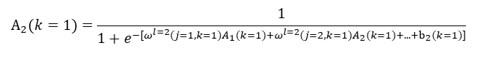
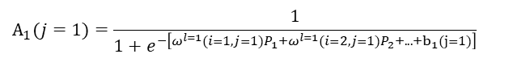
Architecture : Example
$$A_{1}(j=1)=\frac{1}{1+e^{−\left[ω^{l=1}(i=1,j=1)P_{1}+ω^{l=1}(i=2,j=1)P_{2}+...+b_{1}(j=1)\right]}}$$
$$A_{2}(k=1)=\frac{1}{1+e^{−[ω^{l=2}(j=1,k=1)A_{1}(k=1)+ω^{l=2}(j=2,k=1)A_{2}(k=1)+...+b_{2}(k=1)]}}$$
P(i=1)
ω^{l=1}(i=1,j=1)
A1
ω ^{l=2}(i=1,k=1)
ω^{l=1}(i=2,j=1)
Neuron i=1
Bias=b1(i=1)
A₁(i=1)
ω ^{l=2}(i=2,k=1)
Neuron k=1
Bias=b2(k=1)
P(i=2)
A2
P(i=9)
ω^{l=1}(i=9,j=1)
A5
ω ^{l=2}(i=5,k=1)
A_{2(k=2)}
P(i=1)
P(i=2)
P(i=3)
:
:
P(i=9)
ω ^{l=1}(i=1,j=1)
A1(j=1)
ω ^{l=2}(j=1,k=1)
ω ^{l=1}(i=2,j=1)
A1(j=2)
ω ^{l=2}(j=2,k=1)
ω ^{l=2}(j=2,k=2)
ω^{l=1}(i=3,j=4)
ω ^{l=2}(j=5,k=3)
A2:layer2, 3 Output neurons
indexed by k
W^{l=2}=5x3
b^{l=2}=3x1
A1(j=5)
ω ^{l=1}(i=9,j=5)
A1: Hidden layer1 =5 neurons, indexed by j
W^{l=1}=9x5
b^{l=1}=5x1
Input:
P=9x1
Indexed by i
Layer l=1
Layer l=2
←S2 generated
←S1 generated

Slide 30
Architecture : Example (continue, left hand side first)
$$A_{1}(j=1)=\frac{1}{1+e^{−\left[ω^{l=1}(i=1,j=1)P_{1}+ω^{l=1}(i=2,j=1)P_{2}+...+b_{1}(j=1)\right]}}$$
$$A_{2}(k=1)=\frac{1}{1+e^{−[ω^{l=2}(j=1,k=1)A_{1}(k=1)+ω^{l=2}(j=2,k=1)A_{2}(k=1)+...+b_{2}(k=1)]}}$$
P(i=1)
ω^{l=1}(i=1,j=1)
A1
ω ^{l=2}(i=1,k=1)
ω^{l=1}(i=2,j=1)
Neuron i=1
Bias=b1(i=1)
A₁(i=1)
ω ^{l=2}(i=2,k=1)
Neuron k=1
Bias=b2(k=1)
P(i=2)
A2
P(i=9)
ω^{l=1}(i=9,j=1)
A5
ω ^{l=2}(i=5,k=1)
A_{2(k=2)}
P(i=1)
P(i=2)
P(i=3)
:
:
P(i=9)
ω ^{l=1}(i=1,j=1)
A1(j=1)
ω ^{l=2}(j=1,k=1)
ω ^{l=1}(i=2,j=1)
A1(j=2)
ω ^{l=2}(j=2,k=1)
ω ^{l=2}(i=2,k=2)
ω^{l=1}(i=3,j=4)
ω ^{l=2}(j=5,k=3)
A2:layer2, 3 Output neurons
indexed by k
W^{l=2}=5x3
b^{l=2}=3x1
A1(j=5)
ω ^{l=1}(i=9,j=5)
A1: Hidden layer1 =5 neurons, indexed by j
W^{l=1}=9x5
b^{l=1}=5x1
Input:
P=9x1
Indexed by i
Layer l=1
Layer l=2
←S2 generated
←S1 generated

Slide 31
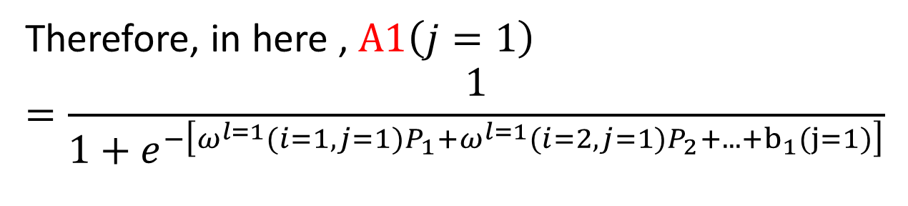
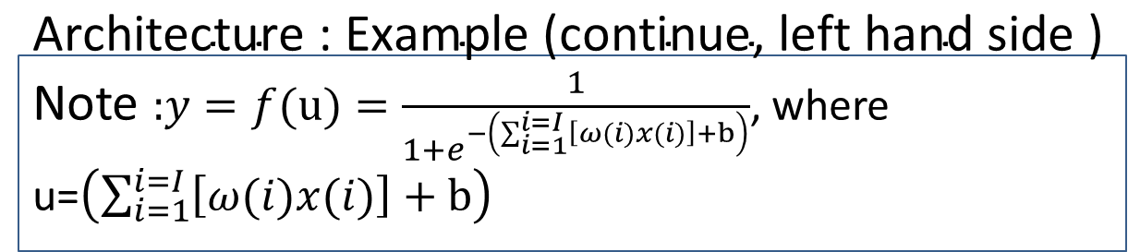
$\text{Architecture}\text{ : }\text{Example}\text{ (}\text{continue}\text{, }\text{left} \text{hand} \text{side}\text{ )}$ Note $\text{:}y=f(u)=\frac{1}{1+e^{−\left(\sum_{i=1}^{i=I}{\left[ω(i)x(i)\right]+b}\right)}}$, where u=$\left(\sum_{i=1}^{i=I}{\left[ω(i)x(i)\right]+b}\right)$
Therefore, in here , $A1\left(j=1\right)$
$$=\frac{1}{1+e^{−\left[ω^{l=1}(i=1,j=1)P_{1}+ω^{l=1}(i=2,j=1)P_{2}+...+b_{1}(j=1)\right]}}$$
P(i=1)
ω^{l=1}(i=1,j=1)
P(i=2)
ω^{l=1}(i=2,j=1)
Neuron (j=1)
Bias=b1(j=1)
A1(j=1)
P(i=9)
ω^{l=1}(i=9,j=1)

Slide 32
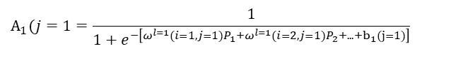
Architecture : $\text{Example}\text{ (}\text{continue}\text{, }\text{right} \text{hand} \text{side}\text{ )}$
$$A_{1}(j=1=\frac{1}{1+e^{−\left[ω^{l=1}(i=1,j=1)P_{1}+ω^{l=1}(i=2,j=1)P_{2}+...+b_{1}(j=1)\right]}}$$
$$A_{2}(k=1)=\frac{1}{1+e^{−[ω^{l=2}(j=1,k=1)A_{1}(k=1)+ω^{l=2}(j=2,k=1)A_{2}(k=1)+...+b_{2}(k=1)]}}$$
P(i=1)
ω^{l=1}(i=1,j=1)
A1
ω ^{l=2}(j=1,k=1)
ω^{l=1}(i=2,j=1)
Neuron i=1
Bias=b1(i=1)
A₁(i=1)
ω ^{l=2}(j=2,k=1)
Neuron k=1
Bias=b2(k=1)
P(i=2)
A2
P(i=9)
ω^{l=1}(i=9,j=1)
A5
ω ^{l=2}(j=5,k=1)
A_{2(k=2)}
P(i=1)
P(i=2)
P(i=3)
:
:
P(i=9)
ω ^{l=1}(i=1,j=1)
A1(j=1)
ω ^{l=2}(j=1,k=1)
ω ^{l=1}(i=2,j=1)
A1(j=2)
ω ^{l=2}(j=2,k=1)
ω ^{l=2}(i=2,k=2)
ω^{l=1}(i=3,j=4)
ω ^{l=2}(j=5,k=3)
A2:layer2, 3 Output neurons
indexed by k
W^{l=2}=5x3
b^{l=2}=3x1
A1(j=5)
ω ^{l=1}(i=9,j=5)
A1: Hidden layer1 =5 neurons, indexed by j
W^{l=1}=9x5
b^{l=1}=5x1
Input:
P=9x1
Indexed by j
Layer l=1
Layer l=2
←S2 generated
←S1 generated

Slide 33
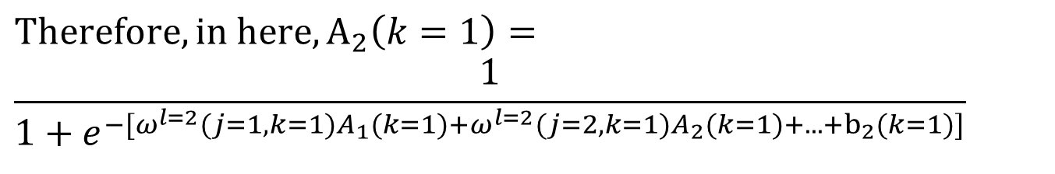
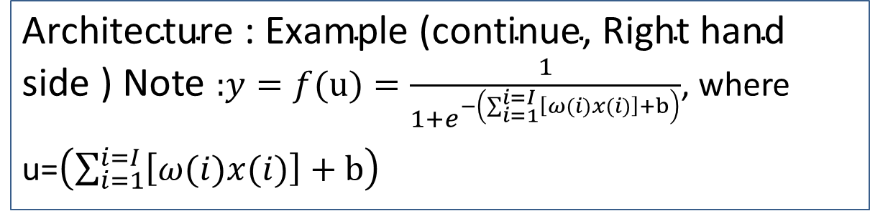
$$\text{Ex}\text{ample}\text{ (}\text{right} \text{hand} \text{side}\text{)}$$
$\text{Architecture}\text{ : }\text{Example}\text{ (}\text{continue}\text{, }\text{Right} \text{hand} \text{side}\text{ )}$ Note $\text{:}y=f(u)=\frac{1}{1+e^{−\left(\sum_{i=1}^{i=I}{\left[ω(i)x(i)\right]+b}\right)}}$, where u=$\left(\sum_{i=1}^{i=I}{\left[ω(i)x(i)\right]+b}\right)$
$$Therefore, in here, A_{2}\left(k=1\right)=$$
$$\frac{1}{1+e^{−[ω^{l=2}(j=1,k=1)A_{1}(k=1)+ω^{l=2}(j=2,k=1)A_{2}(k=1)+...+b_{2}(k=1)]}}$$
ω ^{l=2}(i=1,k=1)
ω ^{l=2}(i=2,k=1)
Neuron k=1
Bias=b2(k=1)
A_{2(k=2)}
A5
ω ^{l=2}(i=5,k=1)

Slide 34
Figure Exercise3: Architecture : Exercise 3
$$A_{1}(j=1)=\frac{1}{1+e^{−\left[ω^{l=1}(i=1,j=1)P_{1}+ω^{l=1}(i=2,j=1)P_{2}+...+b_{1}(j=1)\right]}}$$
$$A_{2}(k=1)=\frac{1}{1+e^{−[ω^{l=2}(j=1,k=1)A_{1}(k=1)+ω^{l=2}(j=2,k=1)A_{2}(k=1)+...+b_{2}(k=1)]}}$$
P(i=1)
ω^{l=1}(i=1,j=1)
A1
ω ^{l=2}(j=1,k=1)
ω^{l=1}(i=2,j=1)
Neuron i=1
Bias=b1(i=1)
A₁(i=1)
ω ^{l=2}(j=2,k=1)
Neuron k=1
Bias=b2(k=1)
P(i=2)
A2
P(i=9)
ω^{l=1}(i=9,j=1)
A5
ω ^{l=2}(j=5,k=1)
A_{2(k=2)}
P(i=1)
P(i=2)
P(i=3)
:
:
P(i=9)
ω ^{l=1}(i=1,j=1)
A1(j=1)
ω ^{l=2}(j=1,k=1)
ω ^{l=1}(i=2,j=1)
A1(j=2)
ω ^{l=2}(j=2,k=1)
ω ^{l=2}(i=2,k=2)
ω^{l=1}(i=3,j=4)
ω ^{l=2}(j=5,k=3)
A2:layer2, 3 Output neurons
indexed by k
W^{l=2}=5x3
b^{l=2}=3x1
A1(j=5)
ω ^{l=1}(i=9,j=5)
A1: Hidden layer1 =5 neurons, indexed by j
W^{l=1}=9x5
b^{l=1}=5x1
Input:
P=9x1
Indexed by j
Layer l=1
Layer l=2
←S2 generated
←S1 generated

Slide 35
Exercise 3a,b
Exercise 3a : In Figure Exercise3 , how many inputs, hidden neurons, outputs, weights and biases in each layer?
Answer3a: Inputs=9, hidden neurons=5, outputs=3, weights in hidden layer (layer1) =9x5, neurons in output layer (layer2)= 5x3, 5 biases in hidden layer (layer1), 3 biases in output layer (layer2)
Exercise 3b: Find A1 (i=4), the output of the 4th neuron in the hidden layer.

Slide 36
Answer (Exercise3b: write values for A1(j=4)
P(i=1)
ω^{l=1}(i=1,j=4)
P(i=2)
ω^{l=1}(i=2,j=4)
Neuron Bias=b
A1_j_is_4
P(i=9)
ω^{l=1}(i=9,j=4)
Example: if P=[ 0.7656 0.7344 0.9609 0.9961 0.9141 0.9063 0.0977 0.0938 0.0859]
ω^{l =1}=[ 0.2112 0.1540 -0.0687 -0.0289 0.0720 -0.1666 0.2938 -0.0169 -0.1127]
b^{l=1}= 0.1441 %for neuron i
%Find A1(i=4)
Answer:
U1=0.7656*0.2112 + 0.7344*0.1540 + 0.9609* -0.0687 + 0.9961 *-0.0289 0.9141 *0.0720 + 0.9063 *-0.1666 + 0.0977* 0.2938 + 0.0938*-0.0169 + 0.0859 *-0.1127
=0.1123
U=u1+b= 0.1123+ 0.1441= 0.2564
A1_i_is_4=1/(1+exp(- 0.2564))=0.564
A1_i_is_4=1/(1+exp[-(ω^{l=1}*P+b^{l=1}))]
=0.564
%Matlab Code:
P=[ 0.7656 0.7344 0.9609 0.9961 0.9141 0.9063 0.0977 0.0938 0.0859];
W=[ 0.2112 0.1540 -0.0687 -0.0289 0.0720 -0.1666 0.2938 -0.0169 -0.1127];
bias=0.1441;
1/(1+exp(-1*(sum(P.*W)+bias)) ) %correct 0.5637

Slide 37
Exercise 4: find Y1
Layers are indexed by l
Neurons are indexed by i
Weights are indexed by j
b=bias
l=1
i=1
X=1
NA1
l=3
i=1
b=0.7
0.1
l=2
i=1
b=0.5
0.6
0.35
Y1
=?
l=1
i=2
0.4
0.35
X=3.1
0.27
0.73
0.25
NA2
l=3
i=2
b=0.6
0.15
0.8
y2
l=2
i=2
b=0.3
l=1
i=3
X=0.5
W^{l =1}(j=3,i=2)
Hidden layer
ouput layer
Input layer

Slide 38
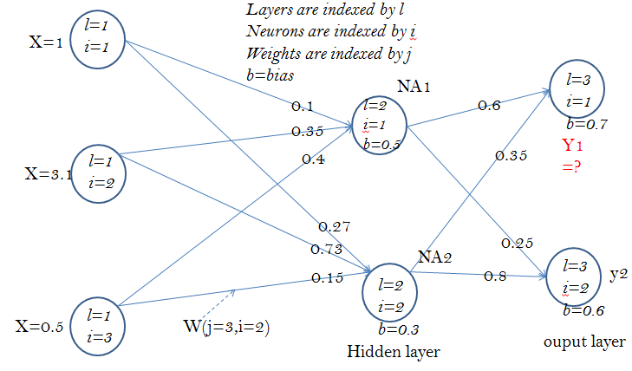
Answer 4
%
u1=1*0.1+3.1*0.35+0.5*0.4+0.5
NA1=1/(1+exp(-1*u1))
%NA1=0.8682
u2=1*0.27+3.1*0.73+0.5*0.15+0.3
NA2=1/(1+exp(-1*u2))
%NA2=0.9482
u_Y1=NA1*0.6+NA2*0.35+0.7
Y1=1/(1+exp(-1*u_Y1))
%Y1= 0.8253

Slide 39

Part 2: Back propagation processing (Training the network)
Back Propagation Neural Net (BPNN) (Training)
Ref:http://en.wikipedia.org/wiki/Backpropagation

Slide 40

Back propagation stage
Part1:Feed
Forward (studied before)
Part2: Back propagation
sensitivity
For training we need to find , why?
We will explain why and prove the necessary equations in the following slides

Slide 41
The criteria to train a network
Based on the overall error function, there are ‘N’ samples and ‘c’ classes to be learned (Assume N=60,000 in MNIST dataset)
In our simple example
the n^{th} training sample
Example: The k-th output neuron y_{k}^{n}
the teacher says
it is class t_{k}^{n}=1
y^{n}_{K=1} ← t^{n}_{k=1}
y^{n}_{K=2} ← t^{n}_{k=2}
y^{n}_{K=3} ← t^{n}_{k=3}
C Output neurons

Slide 42
Before we back propagate data , we have to find the feed forward error signals e(n) first for the training sample x(n). Recall: Feed forward processing, Input =P1,..P9, output =Y1,Y2,Y3, teacher =T1,T2,T3
I.e. e(n)=
(1/2)|Y1-T1|²
=0.5*(0.5101-1)^2
=0.12
Input=
P(i=1)
P(i=2)
P(i=3)
:
:
P(i=9)
ω (i=1,j=1)
A1(j=1)
ω (j=1,k=1)
Y1=0.5101
T1=1
ω (i=2,i=1)
A1(j=2)
ω (j=2,k=1)
Y2=0.4322
T2=0
ω (j=2,k=2)
Y3=0.3241
T3=0
A1(j=5)
Output layer
W^{l=1}=9x5
b^{l=1}=5x1
A1: Hidden layer,
5 neurons,
indexed by j
Layer l=2
W^{l=2}=5x3
b^{l=2}=3x1
Input layer
Layer l=1
e

Slide 43
Exercise 5 : The training idea
Assume it is for the n^{th} training sample, and belong to class C.
In the previous exercise we calculated that in this network Y1= 0.8253
During training for this input the teacher says T=1
What is the error value e?
Answer:____
How do we use this e?
Answer:____
T=1
Assume it is for the n^{th} training sample

Slide 44
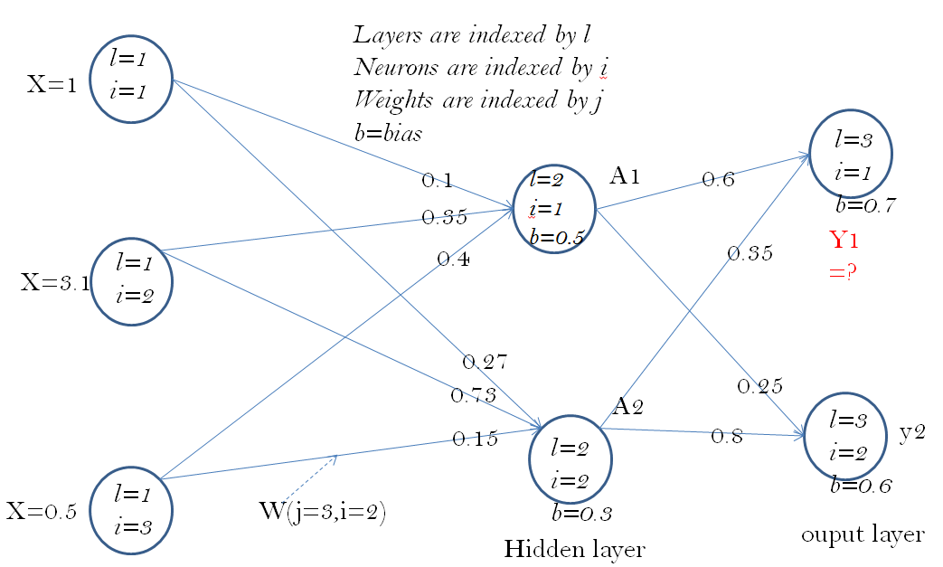
Answer: Exercise 5 : The training idea
Assume it is for the n^{th} training sample, and belong to class C.
In the previous exercise we calculated that in this network Y1= 0.8253
During training for this input the teacher says the target T=1
What is the error value e?
How do we use this e?
Answer a: e=(1/2)|Y1-t|²=0.5*(1-0.8253)^2= 0.0153
Answer b: We feed this e back to the network to find Δw to minimize the overall E (E =sum_all_n [t-e]). It is because we know that w_new=w_old+ Δ w (will prove this later) will give a new w that decreases E. hence by applying this formula recursively, we can achieve a set of W to minimum E.
T=1
e
Assume it is for the n^{th} training sample

Slide 45
How to back propagate?
Neuron j
45
i=1,2,..,I
I inputs to neuron j
Output of neuron j is y_{j}

Slide 46
Because: ∂E/ ∂ w_{i,j} tells you how to change w to minimize e∈E The method is called Learning by gradient decent
Important result

Slide 47
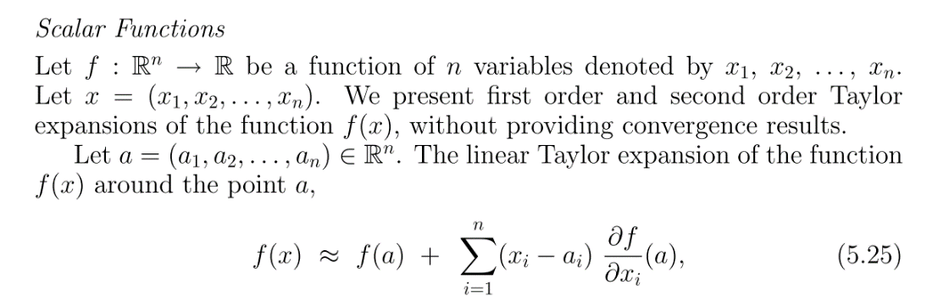
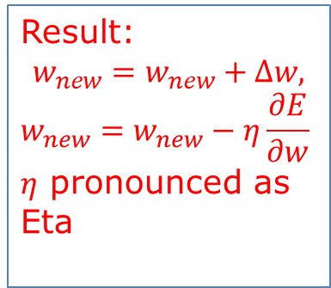
ANS for : We need to find , why?
Using Taylor series
http://www.fepress.org/files/math_primer_fe_taylor.pdf
http://en.wikipedia.org/wiki/Taylor's_theorem
Result:
$$w_{new}=w_{new}+∆w,$$
$$w_{new}=w_{new}−η\frac{∂E}{∂w}$$
$η$ pronounced as Eta
Always +ve

Slide 48
Back propagation idea Input =P1,..P9, output =Y(k=1),Y(k=2),Y3(k=3) teachers =T(k=1),T(k=3),T(k=3)
I.e. e(n)=
(1/2)|Y1-T1|²
=0.5*(0.5101-1)^2
=0.12
Input=
P(i=1)
P(i=2)
P(i=3)
:
:
P(i=9)
ω (i=1,j=1)
A1(j=1)
ω (j=1,k=1)
Y1=0.5101
T1=1
ω (i=2,i=1)
A1(j=2)
ω (j=2,k=1)
Y2=0.4322
T2=0
ω (j=2,k=2)
Y3=0.3241
T3=0
A1(j=5)
Output layer
W^{l=1}=9x5
b^{l=1}=5x1
A1: Hidden layer,
5 neurons,
indexed by j
Layer l=2
W^{l=2}=5x3
b^{l=2}=3x1
Input layer
Layer l=1
e
Neural Networks Ch9. , ver. 6.2f
48

Slide 49

The training algorithm
Write the data structures required for each step of the training algorithm
Initialize all weights w randomly
Iter=1: all_epochs (or break when E is very small)
{ For n=1:N_all_training_samples and classes
{ feed forward x(n) to network to get y(n)
e(n)=0.5*[y(n)-t(n)]^2 ; //t(n)=teacher of sample x(n)
back propagate e(n) to the network,
//showed earlier if Δw=-η*∂E/∂w , and w_{new}=w_{old}+ Δw
//output y(n) will be closer to t(n) hence e(n) will decrease
find Δw=-η*(∂E/∂w); //E will decrease. η≈0.1=learning rate
update w_{new}=w_{old}+ Δw =w_{old}-η*∂E/∂w ; //for weight update
Similarity update b_{new}=b_{old}+ Δb =w_{old}-η*∂e/∂b ; //for bias
}
E=sum_all_n (e(n))
}

Slide 50
How to calculate Δw, Δb of all neurons during training
Formulas and code

Slide 51
Now use this indexing scheme (k,j,i) now
http://cogprints.org/5869/1/cnn_tutorial.pdf
K_{layer}
j_{layer}
i_{layer}
Output teacher
t_{i=1}
t_{i}
Hidden layer l-2
Indexed by k
Hidden layer l-1
Indexed by j
Output layer (l)
indexed by i

Slide 52
Case 1 of weight updating
if the neuron in between the hidden layer and the output layer

Slide 53
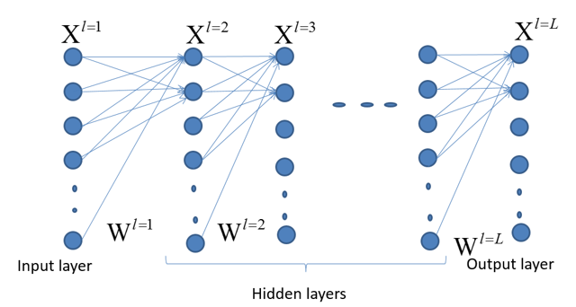
Case 1 of weight updating (i): if the neuron in between the hidden layer and the output layer
Definition
Output
t_{i}
Overall picture
Neuron n as an output neuron
Output
Sensitivity (S2)
s2 = 1*diag(df2) * e(:,i); %e=A2-T;
df2=f’=f(1-f) of layer2, in bnppx.m
Notes:
%%%%%%%%%%%%%%%%%%%%%%%%%%%%%%%%%%%%%%
%%%%%%%%% slide 43 %%%%%%%%%
\subsection{slide 43 Case 1(i): if the neuron in between the output and the hidden layer}
By definition:
$x_i=f(u_i)=
f \Big( \sum\limits_{j=1}^{j=J}(w_{j,i}x_j+b_j)
\Big)
=\frac{1}{
1+exp
\Big(- \sum\limits_{j=1}^{j=J} (w_{j,i}x_j+b_j) \Big)
}$\\
%%%%%%%%%%%%%%%%%%%%%%%%%%%%%%%%%%%%
$\frac{\partial \varepsilon}{\partial w_{i,j}}=
\frac{\partial \varepsilon}{\partial x_j}
\frac{\partial x_j}{\partial u_j}
\frac{\partial u_j}{\partial w_{i,j}}$
%%%%%%%%%%%%%%%%%%%
update $w_{j,i}$ factor,
=term1 $\cdot$ term2 $\cdot$ term3\\
$term1:\frac{\partial \varepsilon }{x_i}=\frac {\partial (0.5)*(x_i - t_i)^2}{\partial x_i}=(x_i - t_i)$\\
$x_i=f(u_i)$ , by definition\\
%%
$term2: \frac{\partial x_i}{\partial u_i}=\frac{\partial f (u_i)}{\partial u_i}=f(u_i)(1-f(u_i))$, proved earlier\\
since $u_i= \sum\limits_{j=1}^{j=J} w_{j,i} x_j+b_j =w_{j,i} x_j+b_j$, for a particular $(j,i)$ pair\\
%%
$term3=\frac{u_j}{w_{j,i}}=\frac{\partial (w_{j,i} \cdot x_j + b_j ) }{\partial w_{j,i}}$, since $b_j$=constant\\
Note : term1 $\cdot term2=\frac{\partial \varepsilon }{\partial u_i }
=\frac{\partial \varepsilon }{\partial x_i }
\frac{\partial x_i }{\partial u_i }=s_i$ is called the sensitivity\\
$s_i=(x_i-t_i) \cdot f(u)(1-f(u))$---(2)\\
since $\frac{\partial \varepsilon}{\partial w_{j,i}}=term1 \cdot term2 \cdot term3$\\
%
$\frac{\partial \varepsilon}{\partial w_{j,i}}=s_ix_j=[(x_i-t_i) \cdot f(u_i)(1-f(u))] \cdot x_j$\\
Note:$ f(u_i)(1-f(u))] \cdot x_j$ is sensitivity (s2)
\begin{verbatim}
%The code:
s2 = 1*diag(df2) * e(:,i); %e=A2-T;
df2=f’=f(1-f) of layer2, in bnppx.m
\end{verbatim}

Slide 54
Case 1 of weight updating : (ii) if the neuron in between the hidden layer and the output layer More Explanation for term1
Definition
Output
t_{i}
Neuron n as an output neuron
Output
Notes:
\subsection{slide 44 Case 1(ii): if the neuron in between the output and the hidden layer}
%%%%%%%%%%%%%%%%%%%%%%%%%%%%%%%%%%%%
$\frac{\partial \varepsilon}{\partial w_{i,j}}=
\frac{\partial \varepsilon}{\partial x_j}
\frac{\partial x_j}{\partial u_j}
\frac{\partial u_j}{\partial w_{i,j}}$
%%%%%%%%%%%%%%%%%%%
update $w_{j,i}$ factor,
=term1 $\cdot$ term2 $\cdot$ term3\\
=update $w_{j,i}$ factor\\
i.e. $w_{j,i(new)}+w_{j,i(old)}+\Delta w_{j,i}$\\
by definition $\varepsilon =\frac {\partial (0.5)*(x_i - t_i)^2}{\partial x_i}$, therefore \\
$term1:\frac{\partial \varepsilon }{x_i}=\frac {\partial (0.5)*(x_i - t_i)^2}{\partial x_i}=(x_i - t_i)$\\

Slide 55
Case 1 of weight updating(iii): if the neuron in between the output and the hidden layer
More Explanation for term2
Output
t_{i}
Neuron n as an output neuron
Output

Slide 56
Case 1(iv): if the neuron in between the output and the hidden layer
More Explanation for term3
Definition
Output
t_{i}
Neuron n as an output neuron
Output

Slide 57
Case 1(v): if the neuron in between the output and the hidden layer
More Explanation
term1*term2*term3
Definition
Output
t_{i}
Neuron n as an output neuron
term1
term2
Output

Slide 58
Case2 of weight updating
if neuron in between a hidden and hidden layer

Slide 59
Case2 of weight updating (i) : if neuron in between a hidden and hidden layer. We want to find
A1
Weight
Layer L
Indexed by i
sensitivity of layer indexed by i
Overall picture
Output
layer
S_{j}: sensitivity for layer j to i
Notes:
%%%%%%%%%%%%%%%%%%%%%%%%%%%%%%%%%%%%%%%%
\subsection{Slide 48: Case2 : if neuron in between a hidden to hidden layer. We want to find}
$\frac{\partial \varepsilon }{\partial w_{i,j}}=
\frac{\partial \varepsilon }{\partial x_j}
\frac{\partial x_j}{\partial u_j}
\frac{\partial u_j}{\partial w_{k,j}}$
%
%update $w_{j,i}$ factor,
$=term1 \cdot term2 \cdot term3$\\
$term1=\frac{\partial \varepsilon}{\partial x_j}
=\sum\limits_{i=1}^{i=I}
\Big(
\frac{\partial \varepsilon }{\partial u_i}
\frac{\partial u_i}{\partial x_j }
\Big)
=\sum\limits_{i=1}^{i=I}(part1a \cdot part1b)$
---(*)\\
%
Part1a: $\frac{\partial \varepsilon }{\partial u_i}=s_i $ (sensitivity in layer $i$)\\
%
=$term1 \cdot term2$ in case 1 discussed earlier\\
part1b: $\frac{\partial u_i }{\partial x_j}=w_{j,i} , $ since $u_i=w_{j,i} \cdot x_j $ for the (j,i) pair\\
So put in (*)
to find term1, hence $\frac{\partial \varepsilon }{\partial x_j}=
\sum\limits_{i=1}^{i=I}(s_i \cdot w_{j,i})$\\
%
$term2= \frac{\partial x_j}{\partial u_j}=[f(u_j)(1-f(u_j)]=$df1 in bnppx.m, since $x_j=f(u_j)$\\
%
$term3=\frac{\partial u_j}{\partial w_{k,j}}=x_k,$ since $u_j=w_{k,j} \cdot x_k$ for the $(k,j)$ pair\\
%
$\frac{\partial \varepsilon }{\partial w_{k,j}}= \Big(
\sum\limits_{i=1}^{i=I}(s_i \cdot \cdot w_{j,i})
\Big)
\cdot [f(u_j)(1-f(u_j)] \cdot x_k$\\
Note: $s_i$ is called the ``sensitivity'' for layer $j$ to $i$

Slide 60
Case2 of weight updating (ii) : if neuron in between a hidden and hidden layer. We want to find
A1
Weight
Layer L
Indexed by i
Note: back-propagate to w_{k,j} depends on all w_{j,i=1,,.I}
Output
layer

Slide 61
Case2(iii) : if neuron in between a hidden and hidden layer. We want to find
A1
Weight
Layer L
Indexed by i
Output
layer

Slide 62
Case2(iv) : if neuron in between a hidden and hidden layer. We want to find
A1
Weight
Layer L
Indexed by i
Output
layer

Slide 63
Essential MATLAB code in bpnn(versionx).m see appendix for source listing
%back propagation pass
df1=A1(:,i).*(1-A1(:,i)); % derivative of A1
df2=A2(:,i).*(1-A2(:,i)); % derivative of A2
s2 = 1*diag(df2) * e(:,i); %e=A2-T; df2=f’=f(1-f) of layer2
s1 = diag(df1)* W2'* s2; % eq(3),feedback, from s2 to S1
W2 = W2-0.1*s2*A1(:,i)'; %learning rate=0.1, equ(2) output case
b2 = b2-0.1*s2; %threshold
W1 = W1-0.1*s1*P(:,i)';% update W1 in layer 1, see equ(3) hidden case
b1 = b1-0.1*s1;%threshold
%forward pass again
A1(:,i)=logsig(W1*P(:,i)+b1);%forward again
A2(:,i)=logsig(W2*A1(:,i)+b2);%forward again

Slide 64
Exercise 6: question on output layer see reference code in appendix
Case 1 of weight updating as discuses earlier

Slide 65
Answer(6a) : on output layer
Example of Case 1
of weight updating
term1
term2
term3

Slide 66
Answer (6b) on output layer: Draw the diagram of related neurons
Draw the diagram
Neuron n as an output neuron
Teacher
(Target )
Class=t_{k} =1
A neuron in
output layer
Output

Slide 67
Answer (6c) on output layer

Slide 68
Example of Case 2
of weight updating
s2
w2
df1
Exercise 7 on hidden layer (case 2 of weight updating as discussed earlier):
df1= 0.2490 %given , dlogsign(u)=f’(u)=f(u)*(1-fu)
This is δ_{k,} %δ_{k=1,2,3}= the vector ss2 in the program
df1= 0.2490 %(given)
X_i= 0.7656 %(given)
s2=[ -0.2527 0.2237 0.2898] %sensitivity vector, call it s2 here
%W(j=1,k=1,2,3)=w2 %weight vector
w2= [-0.0026 -0.1581 0.2707] %weights between hidden to output neurons
%Question (7a): Find = dE/dw=______________________________?
%Question (7b): Draw the diagram of the related neurons

Slide 69
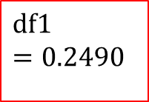
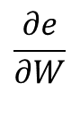
Answer (7a,7b) on hidden to hidden layer Case 2
A1
A2
0.0026
$$\frac{∂e}{∂W}$$
A neuron in
Hidden layer
-0.2527
$$\text{df}\text{1} \\ =\text{0.2490}$$
-0.1581
de_dw=s2*transpose(w2)*df1*X_i
= (-0.2527*-0.0026) + (0.2237* -0.1581) + (0.2707* 0.2898 )) *0.2490*0.7656
de_dw = 0.0083
%------------- to show detailed calculation ---------------
%--This is the matlab code for the above calculation--
%use matlab %%%%%%%%%%%%%%%
s2=[ -0.2527 0.2237 0.2898]
w2= [-0.0026 -0.1581 0.2707]
df1= 0.2490
X_i= 0.7656
de_dw=s2*transpose(w2)*df1*X_i=
%answer de_dw = 0.0083
0.2237
0.2898
0.2707
Case2:Term*term2=sensitivity 1 (ss1 for later use)
Case2: term3

Slide 70
Finally, all (∂e/∂w) terms are found after you solved case1 and case2

Slide 71
Exercise 8: The training algorithm
Write the data structures required for each step of the training algorithm, online_training (min_batch=1 case)
Iter=1: all_epochs (or break when E is very small)
{ For n=1:N_all_training_samples
{ feed forward x(n) to network to get y(n)
e(n)=0.5*[y(n)-t(n)]^2 ;//t(n)=teacher of sample x(n)
back propagate e(n) to the network,
//showed earlier if Δw=-η*∂E/∂w , and w_{new}=w_{old}+ Δw
//output y(n) will be closer to t(n) hence e(n) will decrease
find Δw=-η*∂E/∂w //E will decrease. η≈0.1=learning rate
update w_{new}=w_{old}+ Δw =w_{old}-η*∂E/∂w ;//for weight
Similarity update b_{new}=b_{old}+ Δb =b_{old}-η*∂E/∂b ;//for bias
}
E=sum_all_n (e(n))
}

Slide 72
Answer 8: The training algorithm Data structures used can be found in the program at appendix
Write the data structures required for each step of the training algorithm
Iter=1: all_epochs (or break when E is very small)
{ For n=1:N_all_training_samples and classes
{ feed forward x(n) to network to get y(n)
e(n)=0.5*[y(n)-t(n)]^2 ;//t(n)=teacher of sample x(n)
back propagate e(n) to the network,
//showed earlier if Δw=-η*∂E/∂w , and w_{new}=w_{old}+ Δw
//output y(n) will be closer to t(n) hence e(n) will decrease
find Δw=-η*∂E/∂w //E will decrease. η≈0.1=learning rate
update w_{new}=w_{old}+ Δw =w_{old}-η*∂E/∂w ; //for weight
Similarity update b_{new}=b_{old}+ Δb =b_{old}-η*∂e/∂b ; //for bias
}
E=sum_all_n (e(n))
}

Slide 73
(self study question)

Slide 74
Ex10. (self study question) Case 1: when the neuron in between the output and the hidden layer
Definition
Output
t_{i}
Neuron n as an output neuron
Output
http://cogprints.org/5869/1/cnn_tutorial.pdf

Slide 75
Ex.11 (self study question): Case2 : when neuron in between a hidden and hidden layer. We want to find
A1
Weight
Layer L
Indexed by k
S2= sensitivity of layer 2 neurons
Output
layer

Slide 76
Ex12a (self study question)
Give the following diagram (in next slide) showing the parameters of part of a neural network at time k. Other neurons and weights exist but not shown.
The activation function of the neurons is sigmoid.
Find the output [y1,y2]’ at time k.
If the target code is [t1, t2]’=[1,0]’, when training the neural network, find the new w11,w12,w13,w21,w22,w23 at time k+1.
Find the new wh1 at time k+1. Assume all the weights will be updated together only after all delta weights (Δw) have been calculated for each epoch k.

Slide 77
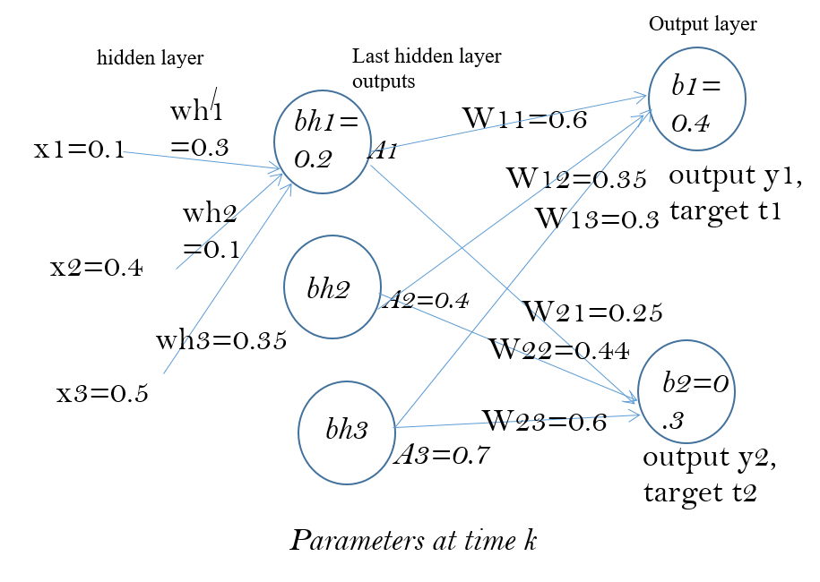
d
EX12b (self study question)
d

Slide 78
Implementation issues
Speed up training: Full Batch and mini-batch weight update
A Simple Way to Prevent Neural Networks from Overfitting : Dropout
Popular optimization algorithm: ADAM

Slide 79
Full batch and min-batch
Full batch: Neural networks are trained in a series of epochs. Each epoch consists of one forward pass and one backpropogation pass over all of the provided training samples. Naively, we can compute the true gradient by computing the gradient value of each training case independently, then summing together the resultant vectors. This is known as full batch learning, and it provides an exact answer to the question of which stepping direction is optimal, as far as gradient descent is concerned.
Mini-batch: Alternatively, we may choose to update the training weights several times over the course of a single epoch. In this case, we are no longer computing the true gradient; instead we are computing an approximation of the true gradient, using however many training samples are included in each split of the epoch. This is known as mini-batch learning. (see example in next slide)
In the most extreme case we may choose to adjust the gradient after every single forward and backwards pass. This is known as online learning.
The amount of data included in each sub-epoch weight change is known as the batch size. For example, with a training dataset of 1000 samples, a full batch size would be 1000, a mini-batch size would be 500 or 200 or 100, and an online batch size would be just 1.
https://www.kaggle.com/residentmario/full-batch-mini-batch-and-online-learning

Slide 80
Mini_batch weight update by averaging, a typical method
https://stats.stackexchange.com/questions/266968/how-does-minibatch-gradient-descent-update-the-weights-for-each-example-in-a-bat/266977
If your model has 5 weights and you have a mini-batch size of 2 (2 samples or examples) then you might get this:
Example 1. Loss=2, gradients = (1.5,−2.0,1.1,0.4,−0.9)
Example 2. Loss=3, gradients=(1.2,2.3,−1.1,−0.8,−0.7)
The average of the gradients in this mini-batch are calculated, they are (1.35,0.15,0,−0.2,−0.8), which
will be used to update the weights)
a=[1.5,-2.0,1.1,0.4,-0.9],b=[1.2,2.3,-1.1,-0.8,-0.7], (a+b)/2
% 1.3500 0.1500 0 -0.2000 -0.8000

Slide 81
Dropout
Dropout: A Simple Way to Prevent Neural Networks from Overfitting by Nitish Srivastava
http://jmlr.org/papers/volume15/srivastava14a/srivastava14a.pdf

Slide 82
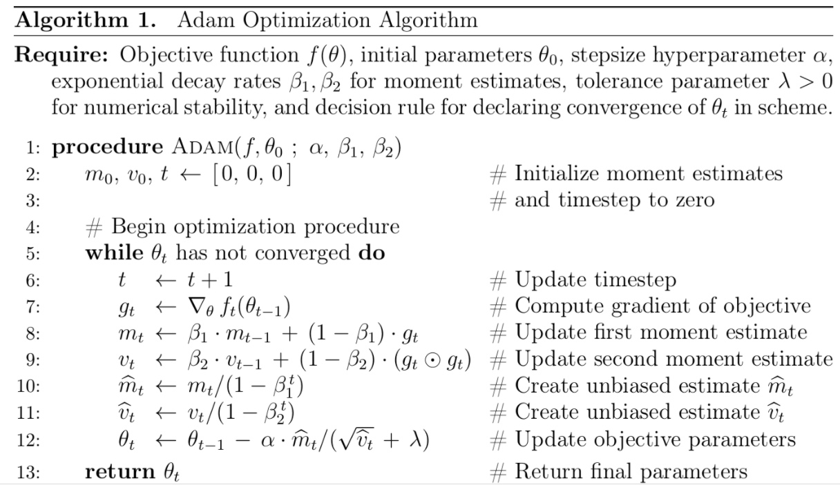
Adam Optimization Algorithm (Adaptive Moment estimation)
https://www.math.purdue.edu/~nwinovic/deep_learning_optimization.html
https://www.researchgate.net/figure/Adam-optimizer-algorithm_fig2_339075038
m initialized as 0 at the beginning

Slide 83
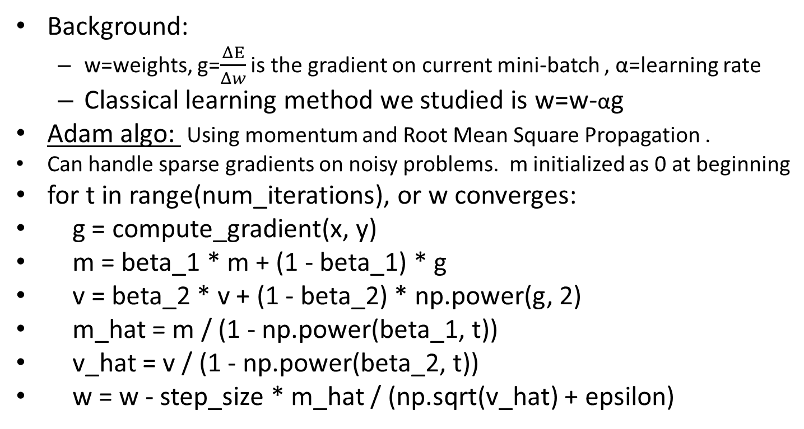
ADAM optimization algorithm/code https://towardsdatascience.com/adam-latest-trends-in-deep-learning-optimization-6be9a291375c https://www.geeksforgeeks.org/intuition-of-adam-optimizer/
Background:
w=weights, g=$\frac{ΔE}{Δw}$ is the gradient on current mini-batch , α=learning rate
Classical learning method we studied is w=w-αg
Adam algo: Using momentum and Root Mean Square Propagation .
Can handle sparse gradients on noisy problems. m initialized as 0 at beginning
for t in range(num_iterations), or w converges:
g = compute_gradient(x, y)
m = beta_1 * m + (1 - beta_1) * g
v = beta_2 * v + (1 - beta_2) * np.power(g, 2)
m_hat = m / (1 - np.power(beta_1, t))
v_hat = v / (1 - np.power(beta_2, t))
w = w - step_size * m_hat / (np.sqrt(v_hat) + epsilon)
Example:
beta_1(β1) ≈ 0.9
beta_2 (β2)≈ 0.001
step_size(α) ≈0.001
epsilon(ε) ≈ 10^-8
Python code with numpy
np.sqrt(x)=x², np.power(a,b)=a^{b}
Ref:
https://www.math.purdue.edu/~nwinovic/deep_learning_optimization.html
https://medium.com/@nishantnikhil/adam-optimizer-notes-ddac4fd7218
https://sefiks.com/2018/06/23/the-insiders-guide-to-adam-optimization-algorithm-for-deep-learning/

Slide 84
Summary
Studied what is Back Propagation Neural Networks (BPNN)
Studied the forward pass
Studied how to back propagate data during training of the BPNN network
Studied implementation issues of neural BPNN networks

Slide 85
References
Wiki
http://en.wikipedia.org/wiki/Backpropagation
http://en.wikipedia.org/wiki/Convolutional_neural_network
Matlab programs
Neural Network for pattern recognition- Tutorial http://www.mathworks.com/matlabcentral/fileexchange/19997-neural-network-for-pattern-recognition-tutorial
CNN Matlab example http://www.mathworks.com/matlabcentral/fileexchange/38310-deep-learning-toolbox
Open source library
Tensor flow: http://www.geekwire.com/2015/google-open-sources-tensorflow-machine-learning-system-offering-its-neural-network-to-outside-developers/

Slide 86
Appendices

Slide 87
Recurrent-dropout in LSTM https://medium.com/@bingobee01/a-review-of-dropout-as-applied-to-rnns-72e79ecd5b7b
Like Moon et al., (2015) and Gal and Ghahramani (2015), Semeniuta et al., (2016) proposed applying dropout to the recurrent connections of RNN’s so that recurrent weights could be regularized to improve performance.
Apply dropout out in Dotted lines

Slide 88
Return sequences in tensorflow-keras
Return sequences refer to return the hidden state a^{<t>}. By default, the return_sequences is set to False in Keras RNN layers, and this means the RNN layer will only return the last hidden state output a^{<T>}. The last hidden state output captures an abstract representation of the input sequence. In some case, it is all we need, such as a classification or regression model where the RNN is followed by the Dense layer(s) to generate logits for news topic classification or score for sentiment analysis, or in a generative model to produce the softmax probabilities for the next possible char.
In other cases, we need the full sequence as the output. Setting return_sequences to True is necessary.
https://www.dlology.com/blog/how-to-use-return_state-or-return_sequences-in-keras/

Slide 89
BNPP example in matlab
Based on Neural Network for pattern recognition- Tutorial http://www.mathworks.com/matlabcentral/fileexchange/19997-neural-network-for-pattern-recognition-tutorial

Slide 90
Example: a simple BPNN
Number of classes (no. of output neurons)=3
Input 9 pixels: each input is a 3x3 image
Training samples =3 for each class
Number of hidden layers =1
Number of neurons in the hidden layer =5

Slide 91
Display of testing patterns
Testing patterns , recognition rate = 8/9=88.8889

Slide 92
Architecture
P(i=1)
ω^{l=1}(i=1,j=1)
A1
ω 2(j=1,k=1)
A_{2(k=2)}
ω^{l=1}(i=2,j=1)
Neuron j=1
Bias=b1(j=1)
A₁(j=1)
ω 2(j=2,k=1)
Neuron k=1
Bias=b2(k=1)
P(i=2)
A2
P(i=9)
ω^{l=1}(i=9,j=1)
A5
ω 2(j=5,k=1)
P(i=1)
P(i=2)
P(i=3)
:
:
P(i=9)
ω ^{l=1}(i=i,j=1)
A1(j=1)
ω ^{l=2}(j=1,k=1)
ω ^{l=1}(i=2,j=1)
A1(j=2)
ω ^{l=2}(j=2,k=1)
ω ^{l=2}(j=2,k=2)
ω^{l=1}i(j=3,j=4)
ω ^{l=2}(j=5,k=3)
A2:layer2, 3 Output neurons
indexed by k
W^{l=2}=5x3
b^{l=2}=3x1
A1(j=5)
ω ^{l=1}(i=9,j=5)
A1: Hidden layer1 =5 neurons, indexed by j
W^{l=1}=9x5
b^{l=1}=5x1
Input:
P=9x1
Indexed by j
Layer l=1
Layer l=2
←S2 generated
←S1 generated

Slide 93
bnpp(version).m program listing
%source : http://www.mathworks.com/matlabcentral/fileexchange/19997-neural-network-for-pattern-recognition-tutorial
%khw bpnn_v201004.m 2020 oct 4,
function ann()
clear memory %comments added by kh wong
clear all
clc
nump=3; % number of classes
n=3; % number of images per class
% training images reshaped into columns in P
% image size (3x3) reshaped to (1x9)
% training images set A
%sample , data set A, you may create another testing set
% <--class 1--> <--class 2--> <--class 3---->
% 1, 2, 3, 4, 5, 6, 7, 8, 9 <= sample index
PA=[196 188 246 255 234 232 25 24 22
35 15 48 223 255 255 53 25 35
234 236 222 224 205 231 224 205 231
232 244 225 255 251 247 255 251 247
59 44 40 10 12 38 15 10 38
244 228 226 255 251 246 25 25 24
243 251 208 249 238 190 249 238 190
57 48 35 255 253 236 55 53 36
226 230 234 235 240 250 235 240 250];
34 44 64 237 228 239 235 240 250];
P=PA;
N=P+round(rand(9,9)*50); %add noise to create the testing samples
% Normalization, to make each pixel value 0->1
P=(P/256);
N=(N/256);
Training patterns

Slide 94
% display the training images
figure(1),
for i=1:n*nump
im=reshape(P(:,i), [3 3]);
%remove theline below to reflect the truth data input
% im=imresize(im,20); % resize the image to make it clear
subplot(nump,n,i),imshow(im);…
title(strcat('Train image/Class #', int2str(ceil(i/n))))
end
% display the testing images
figure,
for i=1:n*nump
im=reshape(N(:,i), [3 3]);
% remove theline below to reflect the truth data input
% im=imresize(im,20); % resize the image to make it clear
subplot(nump,n,i),imshow(im);title(strcat('test image #', int2str(i)))
end

Slide 95
% targets
T=[ 1 1 1 0 0 0 0 0 0
0 0 0 1 1 1 0 0 0
0 0 0 0 0 0 1 1 1 ];
S1=5; % numbe of hidden layers
S2=3; % number of output layers (= number of classes)
[R,Q]=size(P);
epochs = 10000; % number of iterations
goal_err = 10e-5; % goal error
a=0.3; % define the range of random variables
b=-0.3;
W1=a + (b-a) *rand(S1,R); % Weights between Input and Hidden Neurons
W2=a + (b-a) *rand(S2,S1); % Weights between Hidden and Output Neurons
b1=a + (b-a) *rand(S1,1); % Weights between Input and Hidden Neurons
b2=a + (b-a) *rand(S2,1); % Weights between Hidden and Output Neurons
n1=W1*P;
A1=logsig(n1); %feedforward the first time
n2=W2*A1;
A2=logsig(n2);%feedforward the first time
e=A2-T; %actually e=T-A2 in main loop
error =0.5* mean(mean(e.*e)); % better say e=T-A2 , but no harm to error here
nntwarn off

Slide 96
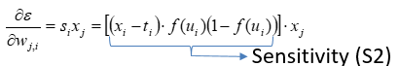
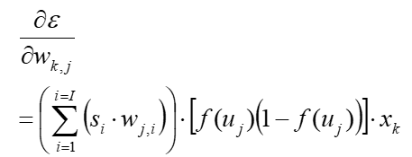
A1 A2 e T
S2 deals with output neurons (case1)
A2=x_{j}
S2= 1*diag(df2)*e
for itr =1:epochs
if error <= goal_err
break
else
for i=1:Q %i is index to a column in P(9x9), for each column of P ( P:,i)
%df1=dlogsig(n1,A1(:,i)); % derivative of A1
df1=A1(:,i).*(1-A1(:,i)); % derivative of A1
%df2=dlogsig(n2,A2(:,i));% derivative of A1
df2=A2(:,i).*(1-A2(:,i)); % derivative of A1
s2 = 1*diag(df2) * e(:,i); %e=A2-T; df2=f’=f(1-f) of layer2
s1 = diag(df1)* W2'* s2; % eq(3),feedback, from s2 to S1
W2 = W2-0.1*s2*A1(:,i)'; %learning rate=0.1, equ(2) output case
b2 = b2-0.1*s2; %threshold
W1 = W1-0.1*s1*P(:,i)';% update W1 in layer 1, see equ(3) hidden case
b1 = b1-0.1*s1;%threshold
A1(:,i)=logsig(W1*P(:,i)+b1);%forward again
A2(:,i)=logsig(W2*A1(:,i)+b2);%forward again
end
e = A2-T ; % for this e, put -ve sign for finding s2
error =0.5*mean(mean(e.*e));
disp(sprintf('Iteration :%5d mse :%12.6f%',itr,error));
mse(itr)=error;
end
end
P W1 W2 A2
s_{i}x_{j}=S2 A2
e=(A2-T)
A2=output neurons, T=target
S1 deals with hidden neurons (case2)
S1=
s2
A1
diag(df1)*W2’

Slide 97
threshold=0.9; % threshold of the system (higher threshold = more accuracy)
% training images result
%TrnOutput=real(A2)
TrnOutput=real(A2>threshold)
% applying test images to NN , TESTING BEGINS HERE
n1=W1*N;
A1=logsig(n1);
n2=W2*A1;
A2test=logsig(n2);
% testing images result
%TstOutput=real(A2test)
TstOutput=real(A2test>threshold)
% recognition rate
wrong=size(find(TstOutput-T),1);
recognition_rate=100*(size(N,2)-wrong)/size(N,2)
% end of code

Slide 98
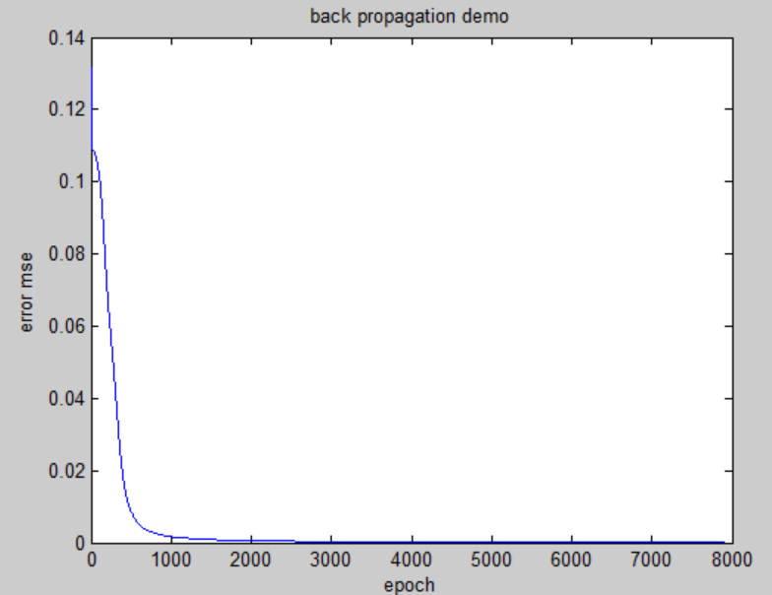
Result of the program mse error vs. itr (epoch iteration)

Slide 99
Bnpp_v201004.m Can display weight (see line 118)
%source : http://www.mathworks.com/matlabcentral/fileexchange/19997-neural-network-for-pattern-recognition-tutorial
%khw bpnn_v201004.m 2020 oct 4,
function ann()
clear memory %comments added by kh wong
clear all
clc
nump=3; % number of classes
n=3; % number of images per class
% training images reshaped into columns in P
% image size (3x3) reshaped to (1x9)
% training images set A
%sample , data set A, you may create another testing set
% <--class 1--> <--class 2--> <--class 3---->
% 1, 2, 3, 4, 5, 6, 7, 8, 9 <= sample index
PA=[196 188 246 255 234 232 25 24 22
35 15 48 223 255 255 53 25 35
234 236 222 224 205 231 224 205 231
232 244 225 255 251 247 255 251 247
59 44 40 10 12 38 15 10 38
244 228 226 255 251 246 25 25 24
243 251 208 249 238 190 249 238 190
57 48 35 255 253 236 55 53 36
226 230 234 235 240 250 235 240 250];
% training images set 2
%sample , data set A, you may create another testing set
% <--class 1--> <--class 2--> <--class 3---->
% 1, 2, 3, 4, 5, 6, 7, 8, 9 <= sample index
PB=[50 20 50 255 215 250 25 24 22
30 23 23 2 12 22 53 25 35
25 5 65 222 232 251 224 205 231
215 180 180 250 235 245 255 251 247
225 212 244 224 234 245 15 10 38
231 203 221 264 225 205 25 25 24
31 18 38 3 3 6 249 238 190
22 22 62 12 32 22 55 53 36
34 44 64 237 228 239 235 240 250];
P=PA;
N=P+round(rand(9,9)*50); %add noise to create the testing samples
% Normalization, to make each pixel value 0->1
P=(P/256);
N=(N/256);
% targets
% <-class 1-> <-class 2-> <-class 3->
% 1, 2, 3, 4, 5, 6, 7, 8, 9 <= sample index
T=[ 1 1 1 0 0 0 0 0 0 %<=target at output neuron 1
0 0 0 1 1 1 0 0 0 %<=target at output neuron 2
0 0 0 0 0 0 1 1 1 ]; %<=target at output neuron 3
S1=5; % number of neurons in the hidden layer
S2=3; % number of neurons in the output layer (= number of classes)
[R,Q]=size(P);
epochs = 10000; % number of iterations
goal_err = 10e-5; % goal error
a=0.3; % define the range of random variables
b=-0.3;
W1=a + (b-a) *rand(S1,R); % Weights between Input and Hidden Neurons
W2=a + (b-a) *rand(S2,S1); % Weights between Hidden and Output Neurons
b1=a + (b-a) *rand(S1,1); % Weights between Input and Hidden Neurons
b2=a + (b-a) *rand(S2,1); % Weights between Hidden and Output Neurons
n1=W1*P;
A1=logsig(n1); %feedforward the first time
n2=W2*A1;
A2=logsig(n2);%feedforward the first time
e=A2-T; %actually e=T-A2 in main loop
error =0.5* mean(mean(e.*e)); % better say e=T-A2 , but no harm to error here
nntwarn off
%%%%%%%%%%%%%%%%%%%%%%----------------%%%%%%%%%%%%%%%%%%%%%%%%%%
save data1; %save data for ananlysis
load data1; %load data for analysis to avoid random data, remove if needed
% display the training and testing images
%DDDDDDDDDDDDDDDDDDDDDDDDDDDDDDDDDDDDDDDDDDDDDDDDDD
figure(1)
clf
for i=1:n*nump
im=reshape(P(:,i), [3 3]);
%remove theline below to reflect the truth data input
% im=imresize(im,20); % resize the image to make it clear
subplot(nump,n,i),imshow(im);
%title(strcat('Train image/Class #,', int2str(ceil(i/n)),num2str(T(:,i))));
title({
[strcat('Train image # ',num2str(i) )]
['class=[', num2str( T(:,i)'),']']
});
% title(strcat('Train image ',num2str(i),'class=', num2str( T(:,i)')));
end
%%%%%%%%%%%%%%%%%% start training ////////////////
for itr =1:epochs
if error <= goal_err
break
else
for i=1:Q % for each column of P ( P:,i), i =input sample index
%weights/biases updated every sample=mini-batch size1=online_training
%df1=dlogsig(n1,A1(:,i)); % derivative of A1,5x1
df1=A1(:,i).*(1-A1(:,i)); % derivative of A1,5x1
%df2=dlogsig(n2,A2(:,i));% derivative of A1,3x1
df2=A2(:,i).*(1-A2(:,i)); % derivative of A1,3x1
s2 = 1*diag(df2) * e(:,i); %e=A2-T; df2=f’=f(1-f) of layer2, 5x1
s1 = diag(df1)* W2'* s2; % eq(3),feedback, from s2 to S1
W2 = W2-0.1*s2*A1(:,i)'; %learnRate=0.1,equ(2) output case, 3x9
b2 = b2-0.1*s2; %threshold , 3x1
W1 = W1-0.1*s1*P(:,i)';%update W1, hidden-to-hidden case2, 5x9
b1 = b1-0.1*s1;%threshold , 3x1
A1(:,i)=logsig(W1*P(:,i)+b1);%forward again, 5x1
A2(:,i)=logsig(W2*A1(:,i)+b2);%forward again, 3x1
% i is sample index, P(:,i) is 9x1 input pixels
% P(:,i)=9x1, df1=5x1, df2=3x1, s1=5x1, s2=3x1, W1=5x9 , W2=3x5,
% b1=5x1, b2=3x1, A1(:,i)=5x1, A2(:,i)=3x1
% show_table1(i,P(:,i),df1,df2,s1,s2,W1,W2,b1,b2,A1(:,i),A2(:,i),T(:,i));
end
e = A2-T ; % for this e, put -ve sign for finding s2
error =0.5*mean(mean(e.*e));
disp(sprintf('Iteration :%5d mse :%12.6f%',itr,error));
mse(itr)=error;
end
%disp('just finished one sample of training, hit key to continue');
% pause
end
threshold=0.9; % threshold of the system (higher threshold = more accuracy)
% training images result
%TrnOutput=real(A2)
TrnOutput=real(A2>threshold)
% applying test images to NN , TESTING BEGINS HERE
n1=W1*N;
A1=logsig(n1);
n2=W2*A1;
A2test=logsig(n2);
% testing images result
%TstOutput=real(A2test)
TstOutput=real(A2test>threshold)
%DDDDDDDDDDDDDDDDDDDDDD2222222222222222222
% display the testing images
figure(2)
clf
for i=1:n*nump
im=reshape(N(:,i), [3 3]);
% remove theline below to reflect the truth data input
% im=imresize(im,20); % resize the image to make it clear
subplot(nump,n,i),imshow(im);
%title(strcat('test image #', int2str(i)))
title({
[strcat('Test image # ',num2str(i) )]
['class found=[', num2str( TstOutput(:,i)'),']']
});
end
% recognition rate
wrong=size(find(TstOutput-T),1);
recognition_rate=100*(size(N,2)-wrong)/size(N,2)
% end of code
figure(4)
clf
plot(mse)
ylabel('error mse')
xlabel('epoch')
title('back propagation demo')
% i is sample index, P(:,i) is 9x1 input pixels
% P(:,i)=9x1, df1=5x1, df2=3x1, s1=5x1, s2=3x1, W1=5x9 , W2=3x5,
% b1=5x1, b2=3x1, A1(:,i)=5x1, A2(:,i)=3x1
function show_table1(i,P_val,df1,df2,s1,s2,W1,W2,b1,b2,A1_vec,A2_vec,T_i)
InputIndex = {'1';'2';'3';'4';'5';'6';'7';'8';'9'};
InputP=P_val;
T_val=[T_i;nan;nan;nan;nan;nan;nan];
W1_1=W1(1,:)';
W1_2=W1(2,:)';
W1_3=W1(3,:)';
W1_4=W1(4,:)';
W1_5=W1(5,:)';
W2_1=[W2(1,:)';nan;nan;nan;nan];
W2_2=[W2(2,:)';nan;nan;nan;nan];
W2_3=[W2(3,:)';nan;nan;nan;nan];
df1_val=[df1;nan;nan;nan;nan];
df2_val=[df2;nan;nan;nan;nan;nan;nan];
s1_val=[s1;nan;nan;nan;nan];
s2_val=[s2;nan;nan;nan;nan;nan;nan];
Bias1_val=[b1;nan;nan;nan;nan];
Bias2_val=[b2;nan;nan;nan;nan;nan;nan];
A1_val=[A1_vec;nan;nan;nan;nan];
A2_val=[A2_vec;nan;nan;nan;nan;nan;nan];
Err=[ norm(A2_vec - T_i) ;nan;nan;nan;nan;nan;nan;nan;nan];
figure(2)
clf
%Weight = [71;69;64;67;64;nan;nan;nan;nan];
%T = table(InputP,W1_1,W1_2,W1_1,W1_3,W1_4,W1_5,Bias1_val,Bias2_val,A1_1,A2_1,'RowNames',InputIndex);
T1 = table(InputP,W1_1,W1_2,W1_3,W1_4,W1_5,df1_val,s1_val,Bias1_val,A1_val,'RowNames',InputIndex);
uitable('Data',T1{:,:},'ColumnName',T1.Properties.VariableNames,...
'RowName',T1.Properties.RowNames,'Units', 'Normalized', ...
'Position',[0, 0, 1, 1]);
title('forward pass A1');
figure(3)
clf
%T2 = table(W2_1,W2_2,W2_3,W2_4,W2_5,df2_val,s2_val,Bias2_val,A2_val,T_val,'RowNames',InputIndex);
T2 = table(W2_1,W2_2,W2_3,df2_val,s2_val,Bias2_val,A2_val,Err,T_val,'RowNames',InputIndex);
uitable('Data',T2{:,:},'ColumnName',T2.Properties.VariableNames,...
'RowName',T2.Properties.RowNames,'Units', 'Normalized', ...
'Position',[0, 0, 1, 1]);
% 'hit key'
% pause

Slide 100
Matlab code,bnpp2c1.m (old version)
%source : http://www.mathworks.com/matlabcentral/fileexchange/19997-neural-network-for-pattern-recognition-tutorial
%khw 2017 aug 23
clear memory %comments added by kh wong
clear all
clc
nump=3; % number of classes
n=3; % number of images per class
% training images reshaped into columns in P
% image size (3x3) reshaped to (1x9)
% training images set 1
% P1=[196 35 234 232 59 244 243 57 226; ...
% 188 15 236 244 44 228 251 48 230; ... % class 1
% 246 48 222 225 40 226 208 35 234; ...
%
% 255 223 224 255 0 255 249 255 235; ...
% 234 255 205 251 0 251 238 253 240; ... % class 2
% 232 255 231 247 38 246 190 236 250; ...
%
% 25 53 224 255 15 25 249 55 235; ...
% 24 25 205 251 10 25 238 53 240; ... % class 3
% 22 35 231 247 38 24 190 36 250]';
% training images set 2
P2=[50 30 25 215 225 231 31 22 34; ... %class1: 1st tranining sample
20 23 5 180 212 203 18 22 44; ... %class1, 2nd tranining sample
50 23 65 180 244 221 38 62 64; ... %class1, 2nd tranining sample
255 2 222 250 224 264 3 12 237; ...
215 12 232 235 234 225 3 32 228; ...
250 22 251 245 245 205 6 22 239; ...
25 53 224 255 15 25 249 55 235; ...
24 25 205 251 10 25 238 53 240; ... % class 3
22 35 231 247 38 24 190 36 250]';
P=P2; %select which set you want to use for traning, khw v15
% testing images
% N=[208 16 235 255 44 229 236 34 247; ...
% 245 21 213 254 55 252 215 51 249; ... % class 1
% 248 22 225 252 30 240 242 27 244; ...
%
% 255 241 208 255 28 255 194 234 188; ...
% 237 243 237 237 19 251 227 225 237; ... % class 2
% 224 251 215 245 31 222 233 255 254; ...
%
% 25 21 208 255 28 25 194 34 188; ...
% 27 23 237 237 19 21 227 25 237; ... % class 3
% 24 49 215 245 31 22 233 55 254]';
N2=P2+round(rand(9,9)*50); %add noise
N=N2;
%'press any key to continue'
%pause
% Normalization
P=P/256;
N=N/256;
% display the training images
figure(1),
clf
for i=1:n*nump
im=reshape(P(:,i), [3 3]);
%remove theline below to reflect the truth data input
% im=imresize(im,20); % resize the image to make it clear
subplot(nump,n,i),imshow(im);
title(strcat('Train image/Class #', int2str(ceil(i/n))))
end
% display the testing images
figure(2)
clf
for i=1:n*nump
im=reshape(N(:,i), [3 3]);
% remove theline below to reflect the truth data input
% im=imresize(im,20); % resize the image to make it clear
subplot(nump,n,i),imshow(im);title(strcat('test image #', int2str(i)))
end
% targets
T=[ 1 1 1 0 0 0 0 0 0
0 0 0 1 1 1 0 0 0
0 0 0 0 0 0 1 1 1 ];
S1=5; % number of neurons in the hidden layer
S2=3; % number of neurons in the output layer (= number of classes)
[R,Q]=size(P);
epochs = 10000; % number of iterations
goal_err = 10e-5; % goal error
a=0.3; % define the range of random variables
b=-0.3;
W1=a + (b-a) *rand(S1,R); % Weights between Input and Hidden Neurons
W2=a + (b-a) *rand(S2,S1); % Weights between Hidden and Output Neurons
b1=a + (b-a) *rand(S1,1); % Weights between Input and Hidden Neurons
b2=a + (b-a) *rand(S2,1); % Weights between Hidden and Output Neurons
n1=W1*P;
A1=logsig(n1); %feedforward the first time
n2=W2*A1;
A2=logsig(n2);%feedforward the first time
e=A2-T; %actually e=T-A2 in main loop
error =0.5* mean(mean(e.*e)); % better say e=T-A2 , but no harm to error here
nntwarn off
for itr =1:epochs
if error <= goal_err
break
else
for i=1:Q %i is index to a column in P(9x9), for each column of P ( P:,i)
%df1=dlogsig(n1,A1(:,i)); % derivative of A1
df1=A1(:,i).*(1-A1(:,i)); % derivative of A1
%df2=dlogsig(n2,A2(:,i));% derivative of A1
df2=A2(:,i).*(1-A2(:,i)); % derivative of A1
s2 = 1*diag(df2) * e(:,i); %e=A2-T; df2=f’=f(1-f) of layer2
s1 = diag(df1)* W2'* s2; % eq(3),feedback, from s2 to S1
W2 = W2-0.1*s2*A1(:,i)'; %learning rate=0.1, equ(2) output case
b2 = b2-0.1*s2; %threshold
W1 = W1-0.1*s1*P(:,i)';% update W1 in layer 1, see equ(3) hidden case
b1 = b1-0.1*s1;%threshold
A1(:,i)=logsig(W1*P(:,i)+b1);%forward again
A2(:,i)=logsig(W2*A1(:,i)+b2);%forward again
end
e = A2-T ; % for this e, put -ve sign for finding s2
error =0.5*mean(mean(e.*e));
disp(sprintf('Iteration :%5d mse :%12.6f%',itr,error));
mse(itr)=error;
end
end
threshold=0.9; % threshold of the system (higher threshold = more accuracy)
% training images result
%TrnOutput=real(A2)
TrnOutput=real(A2>threshold)
% applying test images to NN , TESTING BEGINS HERE
n1=W1*N;
A1=logsig(n1);
n2=W2*A1;
A2test=logsig(n2);
% testing images result
%TstOutput=real(A2test)
TstOutput=real(A2test>threshold)
% recognition rate
wrong=size(find(TstOutput-T),1);
recognition_rate=100*(size(N,2)-wrong)/size(N,2)
% end of code
figure(1)
clf
plot(mse)
ylabel('error mse')
xlabel('epoch')
title('back propagation demo')
%source : http://www.mathworks.com/matlabcentral/fileexchange/19997-neural-network-for-pattern-recognition-tutorial
%khw 2020.Aug.9
clear memory %comments added by kh wong
clear all
clc
nump=3; % number of classes
n=3; % number of images per class
% training images reshaped into columns in P
% image size (3x3) reshaped to (1x9)
% training images set 1
% P1=[196 35 234 232 59 244 243 57 226; ...
% 188 15 236 244 44 228 251 48 230; ... % class 1
% 246 48 222 225 40 226 208 35 234; ...
%
% 255 223 224 255 0 255 249 255 235; ...
% 234 255 205 251 0 251 238 253 240; ... % class 2
% 232 255 231 247 38 246 190 236 250; ...
%
% 25 53 224 255 15 25 249 55 235; ...
% 24 25 205 251 10 25 238 53 240; ... % class 3
% 22 35 231 247 38 24 190 36 250]';
% training images set 2
P2=[50 30 25 215 225 231 31 22 34; ... %class1: 1st tranining sample
20 23 5 180 212 203 18 22 44; ... %class1, 2nd tranining sample
50 23 65 180 244 221 38 62 64; ... %class1, 2nd tranining sample
255 2 222 250 224 264 3 12 237; ...
215 12 232 235 234 225 3 32 228; ...
250 22 251 245 245 205 6 22 239; ...
25 53 224 255 15 25 249 55 235; ...
24 25 205 251 10 25 238 53 240; ... % class 3
22 35 231 247 38 24 190 36 250]';
P=P2; %select which set you want to use for traning, khw v15
% testing images
% N=[208 16 235 255 44 229 236 34 247; ...
% 245 21 213 254 55 252 215 51 249; ... % class 1
% 248 22 225 252 30 240 242 27 244; ...
%
% 255 241 208 255 28 255 194 234 188; ...
% 237 243 237 237 19 251 227 225 237; ... % class 2
% 224 251 215 245 31 222 233 255 254; ...
%
% 25 21 208 255 28 25 194 34 188; ...
% 27 23 237 237 19 21 227 25 237; ... % class 3
% 24 49 215 245 31 22 233 55 254]';
%N2=P2+round(rand(9,9)*50); %add noise
N2=P2; %no random noise, make very run the same.
N=N2;
%'press any key to continue'
%pause
% Normalization
P=P/256;
N=N/256;
% display the training images
figure(1),
clf
for i=1:n*nump
im=reshape(P(:,i), [3 3]);
%remove theline below to reflect the truth data input
% im=imresize(im,20); % resize the image to make it clear
subplot(nump,n,i),imshow(im);
title(strcat('Train image/Class #', int2str(ceil(i/n))))
end
% display the testing images
figure(2)
clf
for i=1:n*nump
im=reshape(N(:,i), [3 3]);
% remove theline below to reflect the truth data input
% im=imresize(im,20); % resize the image to make it clear
subplot(nump,n,i),imshow(im);title(strcat('test image #', int2str(i)))
end
% targets
T=[ 1 1 1 0 0 0 0 0 0
0 0 0 1 1 1 0 0 0
0 0 0 0 0 0 1 1 1 ];
S1=5; % number of neurons in the hidden layer
S2=3; % number of neurons in the output layer (= number of classes)
[R,Q]=size(P);
epochs = 10000; % number of iterations
goal_err = 10e-5; % goal error
a=0.3; % define the range of random variables
b=-0.3;
% W1=a + (b-a) *rand(S1,R); % Weights between Input and Hidden Neurons
% W2=a + (b-a) *rand(S2,S1); % Weights between Hidden and Output Neurons
% b1=a + (b-a) *rand(S1,1); % Weights between Input and Hidden Neurons
% b2=a + (b-a) *rand(S2,1); % Weights between Hidden and Output Neurons
%save('var1.mat','W1','W2','b1','b2');
load 'var1.mat';
n1=W1*P;
A1=logsig(n1); %feedforward the first time
n2=W2*A1;
A2=logsig(n2);%feedforward the first time
e=A2-T; %actually e=T-A2 in main loop
error =0.5* mean(mean(e.*e)); % better say e=T-A2 , but no harm to error here
nntwarn off
for itr =1:epochs
if error <= goal_err
break
else
for i=1:Q %i is index to a column in P(9x9), for each column of P ( P:,i)
%df1=dlogsig(n1,A1(:,i)); % derivative of A1
df1=A1(:,i).*(1-A1(:,i)); % derivative of A1
%df2=dlogsig(n2,A2(:,i));% derivative of A1
df2=A2(:,i).*(1-A2(:,i)); % derivative of A1
s2 = 1*diag(df2) * e(:,i); %e=A2-T; df2=fâ€™=f(1-f) of layer2
s1 = diag(df1)* W2'* s2; % eq(3),feedback, from s2 to S1
W2 = W2-0.1*s2*A1(:,i)'; %learning rate=0.1, equ(2) output case
b2 = b2-0.1*s2; %threshold
W1 = W1-0.1*s1*P(:,i)';% update W1 in layer 1, see equ(3) hidden case
b1 = b1-0.1*s1;%threshold
A1(:,i)=logsig(W1*P(:,i)+b1);%forward again
A2(:,i)=logsig(W2*A1(:,i)+b2);%forward again
end
e = A2-T ; % for this e, put -ve sign for finding s2
error =0.5*mean(mean(e.*e));
disp(sprintf('Iteration :%5d mse :%12.6f%',itr,error));
mse(itr)=error;
end
end
threshold=0.9; % threshold of the system (higher threshold = more accuracy)
% training images result
%TrnOutput=real(A2)
TrnOutput=real(A2>threshold)
% applying test images to NN , TESTING BEGINS HERE
n1=W1*N;
A1=logsig(n1);
n2=W2*A1;
A2test=logsig(n2);
% testing images result
%TstOutput=real(A2test)
TstOutput=real(A2test>threshold)
% recognition rate
wrong=size(find(TstOutput-T),1);
recognition_rate=100*(size(N,2)-wrong)/size(N,2)
% end of code
figure(1)
clf
plot(mse)
ylabel('error mse')
xlabel('epoch')
title('back propagation demo')

Slide 101
Linking up all layers
The previous discussion concentrates on output and one hidden later before the output layer. How to generalize it.
Let do this again using some higher level formulations, in general for two layers, the weight adjustment should be

Slide 102
X^{L-2}, X^{L-1} , X^{L}
W^{L-1} W^{L}
So during training after you initialized the weights and bias, and x,t are given, the rest can be calculated, Δw^{output_layer} can be found
:
:
:
Layer L-2, L-1, L
0.1
given
Can be calculated

Slide 103
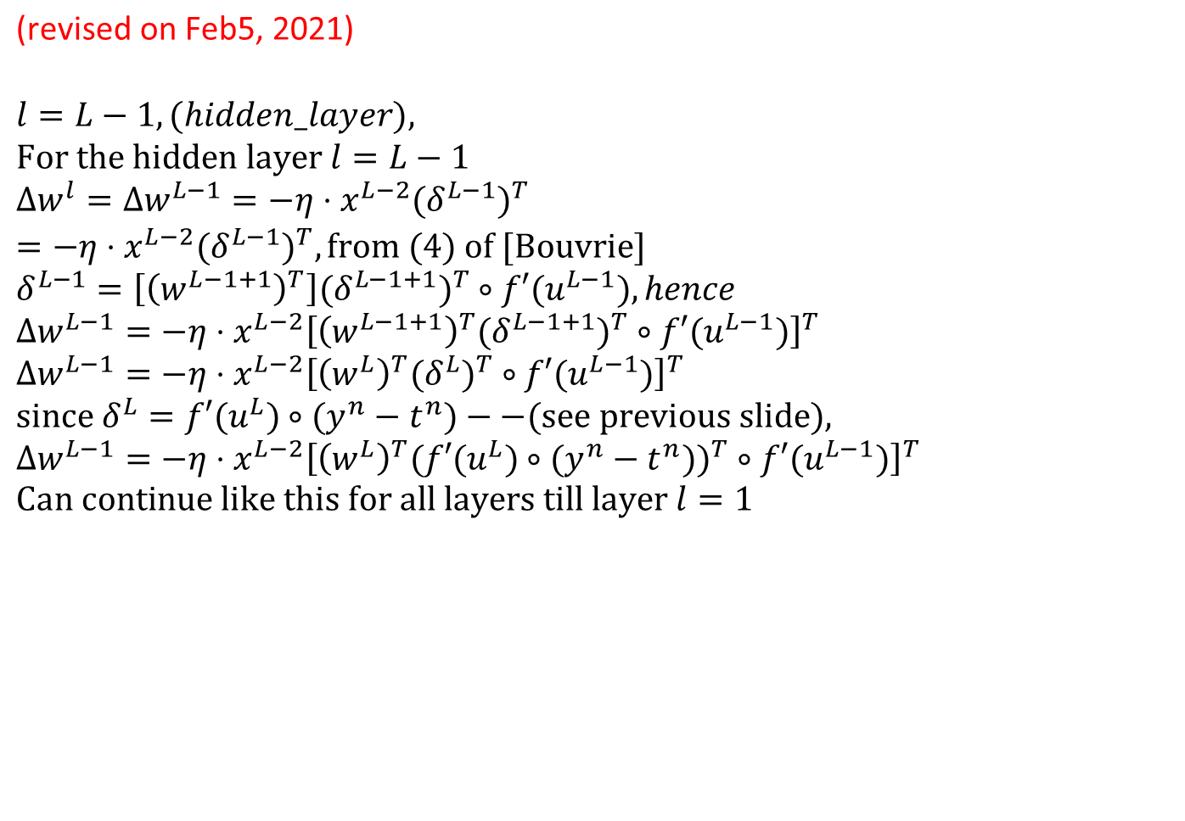
$$\text{(}\text{revised} \text{on} \text{Feb}\text{5, 2021)}$$
$$l=L−1,(hidden_layer), \\ \text{For} \text{the} \text{hidden} \text{layer} l=L−1 \\ Δw^{l}=Δw^{L−1}=−η⋅x^{L−2}(δ^{L−1})^{T} \\ =−η⋅x^{L−2}(δ^{L−1})^{T},\text{from} (4) \text{of} [\text{Bouvrie}]^{} \\ δ^{L−1}=\left[{\left(w^{L−1+1}\right)}^{T}\right](δ^{L−1+1})^{T}∘f′(u^{L−1}),hence \\ Δw^{L−1}=−η⋅x^{L−2}{\left[{\left(w^{L−1+1}\right)}^{T}(δ^{L−1+1})^{T}∘f′(u^{L−1})\right]}^{T} \\ Δw^{L−1}=−η⋅x^{L−2}{\left[{\left(w^{L}\right)}^{T}(δ^{L})^{T}∘f′(u^{L−1})\right]}^{T} \\ \text{since} δ^{L}=f′(u^{L})∘(y^{n}−t^{n})−−(\text{see} \text{previous} \text{slide}), \\ Δw^{L−1}=−η⋅x^{L−2}{\left[{\left(w^{L}\right)}^{T}(f′(u^{L})∘(y^{n}−t^{n}))^{T}∘f′(u^{L−1})\right]}^{T} \\ \text{Can} \text{continue} \text{like} \text{this} \text{for} \text{all} \text{layers} \text{till} \text{layer} l=1$$

Slide 104
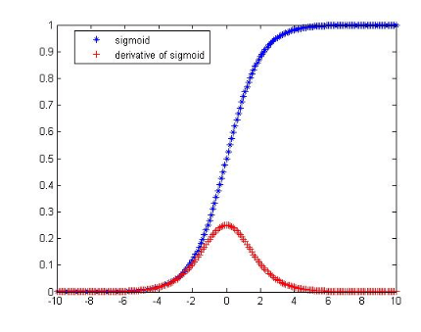
Answer Ex9: Sigmoid function f(u)= logsig(u) and its derivative f’(u)=dlogsig(u)
http://mathworld.wolfram.com/SigmoidFunction.html
Logistic sigmoid (logsig)
https://kawahara.ca/how-to-compute-the-derivative-of-a-sigmoid-function-fully-worked-example/
http://link.springer.com/chapter/10.1007%2F3-540-59497-3_175#page-1

Slide 105
Answer Ex10.Case 1: if the neuron in between the output and the hidden layer
Definition
Output
t_{i}
Neuron n as an output neuron
Output
Sensitivity (S2)
s2 = 1*diag(df2) * e(:,i); %e=A2-T;
df2=f’=f(1-f) of layer2, in bnppx.m
http://cogprints.org/5869/1/cnn_tutorial.pdf

Slide 106
Answer: Ex11: Case2 : if neuron in between a hidden to hidden layer. We want to find
A1
Weight
Layer L
Indexed by k
S2= sensitivity of layer 2 neurons
df1
Output
layer
S1: sensitivity for layer 1 neurons
s1 = diag(df1)* W2'* s2; % eq(3),feedback, from s2 to S1 in bnppx.m

Slide 107
Exercise 12
Give the following diagram (in next slide) showing the parameters of part of a neural network at time k. Other neurons and weights exist but not shown.
The activation function of the neurons is sigmoid.
Exercise 12a: Find the output [y1,y2]’ at time k.
Exercise 12b: If the target code is [t1, t2]’=[1,0]’, and learning_rate=0.1 when training the neural network, find the new w11,w12,w13,w21,w22,w23 at time k+1.
Exercise 12c: Find the new wh1 at time k+1. Assume all the weights will be updated together only after all delta weights (Δw) have been calculated for each epoch k.

Slide 108

Exercise 12:
y1 t1=1
y2 t2=0

Slide 109
Answer Ex12 (ver.2.1) by program
ANSWER:
First find A1=0.609
Answer 12a: all: [y1, y2]=[0.75318,0.740460]
Answer 12b: [new_w21,new_w22,new_w23,new_w21,new_w22,new_w23]=
...[0.602796, 0.351835, 0.303212,0.241327, 0.434308, 0.590039]
Answer 12c: in detail :d_wh1=-0.000192, new_wh1=0.299981
Answer 12c: Answer new_wh1=0.299981
clear
clc
% exercise 12 of lecture note
x=[0.1, 0.4,0.5];
wh=[0.3,0.1,0.35];
bh1=0.2;
learning_rate=0.1;
uh1=x*wh'+bh1;
A1=1/(1+exp(-uh1));
fprintf('First find A1=%3.3f\n',A1);
%A1 = 0.6094
%%%%%%%%%%%%%%%%%%%%%%%%%%%%%%%%%%%%%%%%
wh1=0.3;
A=[A1, 0.4,0.7];
w1=[0.6,0.35,0.3];
w2=[0.25,0.44,0.6];
b1=0.4;
b2=0.3;
%%%%%%%%%%%%%%%%%%%%%%%%%%%%%%%%%%%%%%%
% Q2.1a
u1=A*w1(1:3)'+b1;
%'y1= ';
fu1=1/(1+exp(-u1));
y1=fu1;
%%%%%%%%%%%%%%%%%%%%%%%
% Q2.1b
u2=A*w2(1:3)'+b2;
%'y2= '
fu2=1/(1+exp(-u2));
y2=fu2;
fprintf('Answer 12a: all: [y1, y2]=[%f,%f]\n\n',y1,y2);
%%%%%%%%%%%%%%%%%%%%%%%%%%%%%%%%%%%%%%%
%'now calculate back-propagation parameters'
%Q2.2.a
%dw1=(y-t)*f(u)*(1-f(u))*x
t1=1; %target for y1 output
for i=1:3
s1=(y1-t1)*fu1*(1-fu1);
dw1(i)= -s1*A(i);
new_w1(i)=w1(i)+learning_rate*dw1(i);
end
%%%%%%%%%%%%%%%%%%%
%Q2.2.b
t2= 0;%target for y2 output
for i=1:3
s2=(y2-t2)*fu2*(1-fu2);
dw2(i)= -s2*A(i);
new_w2(i)=w2(i)+learning_rate*dw2(i);
end
fprintf('Answer 12b: [new_w11,new_w12,new_w13,new_w21,new_w22,new_w23]=\n...[%f, %f, %f,%f, %f, %f]\n\n',new_w1(1),new_w1(2),new_w1(3),new_w2(1),new_w2(2),new_w2(3));
%part Q2.3
%d_wh1=-[s1 s2]*[w1(1),w2(1)]'*(uh1*(1-uh1))*x(1);%bug,wrong code,
d_wh1=-[s1 s2]*[w1(1),w2(1)]'*(A1*(1-A1))*x(1);
new_wh1=wh(1)+learning_rate*d_wh1;
fprintf('Answer 12c: in detail :d_wh1=%f, new_wh1=%f\n',d_wh1, new_wh1);
fprintf('Answer 12c: Answer new_wh1=%f\n', new_wh1);
%%
% First find A1=0.609
% Answer 12a: all: [y1, y2]=[0.753185,0.740460]
%
% Answer 12b: [new_w11,new_w12,new_w13,new_w21,new_w22,new_w23]=
% ...[0.602796, 0.351835, 0.303212,0.241327, 0.434308, 0.590039]
%
% Answer 12c: in detail :d_wh1=-0.000192, new_wh1=0.299981
% Answer 12c: Answer new_wh1=0.299981
%

Slide 110
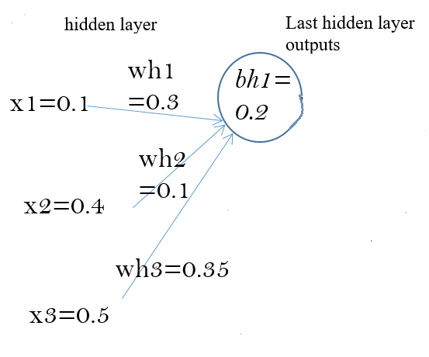

Calculation by hand Step1: find A1 (using equation in case(i))
x=[0.1, 0.4,0.5];
wh=[0.3,0.1,0.35];
bh1=0.2;
learning_rate=0.1;
uh1=x*wh'+bh1;
A1=1/(1+exp(-uh1));
fprintf('First find A1=%3.3f\n',A1);
By hand
Uh1=(0.1*0.3+0.4*0.1+0.5*0.35)+bh1
Uh1=0.245+0.2=0.4450
A1=1/(1+exp(-0.4450))
A1=0.6094
A1
$$Sigmoid fucntion$$
$$f\left(u\right)=\frac{1}{1+e^{−u}}$$

Slide 111
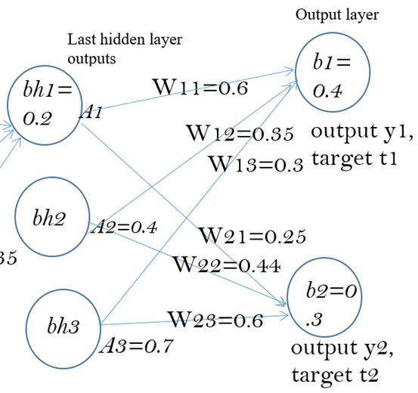
Step2: (forward pass)
wh1=0.3;A=[A1, 0.4,0.7];
w1=[0.6,0.35,0.3];
w2=[0.25,0.44,0.6];
b1=0.4;b2=0.3;
% Q2.1a%%%%%%%%%
u1=A*w1(1:3)'+b1;
%'y1= ';
fu1=1/(1+exp(-u1));
y1=fu1;
% Q2.1b %%%%%%%%%%
u2=A*w2(1:3)'+b2;
%'y2= '
fu2=1/(1+exp(-u2));
y2=fu2;
fprintf('Answer 12a: all: [y1, y2]=[%f,%f]\n\n',y1,y2);
%%%%%%% by hand %%%%
u1=(0.6094*0.6+0.4*0.35+0.7*0.3)+0.4=1.11564
fu1=y1=1/(1+exp(-u1))=y1=1/(1+exp(-1.11564))=0.75318
u2=(0.6094*0.25+0.4*0.44+0.7*0.6)+0.3=1.04835
fu2=y2=1/(1+exp(-u2))=y2=1/(1+exp(- 1.04835))=0.74046
y1=0.75318
y1 t1=1
A1=0.6094
y2=0.74046
y2 t2=0

Slide 112
Step3:
for i=1:3
s1=(y1-t1)*fu1*(1-fu1);
dw1(i)= -s1*A(i);
new_w1(i)=w1(i)+learning_rate*dw1(i);
%case (i) equation
end
%%%% by hand %%%%
% learning_rate =0.1
s1=(y1-t1)*fu1*(1-fu1)
s1=(0.75318-1)*0.75318*(1-0.75318)
=-0.0458838
Similarly (to be used later),
S2=(y2-t2)*fu2*(1-fu2)
S2=(0.740460-0)*0.740460(1-0.740460)=0.1423
dw11= -learning_rate *(s1*A(i));
dw11 =
-learning_rate *(-0.0458838 *0.6094)
New_w11=old_w11+dw11
=0.6+-(0.1*(- 0.04588 *0.6094))
=0.602795
Similarly, for dw12.dw13,dw21,dw22,dw23
The calculation is left for students’ exercises
y1 t1=1
A1=0.6094
s1
y2 t2=0
s2

Slide 113
Step4 (using equation in casew(ii)): weights update for hidden-to-hidden layers
Find wh1
d_wh1=(learning rate)*-[s1 s2]*[w1(1),w2(1)]'*(A1*(1-A1))*x(1); %case (ii) equation
S1=-0.0458838
S2=0.1423
W11=0.6
W21=0.25
Wh1=0.3
A1=0.6094
X1=0.1
Learning_rate=0.1
d_wh1=
-(0.1)*(s1*w11+s2*w12)*A1*(A1-A1)*x1
= -0.1*(-0.0458838
*0.6+0.1423*0.25)*0.6094*(1-0.6094)*0.1
= -0.00001914897
New_Wh1=old_wh1+ d_wh1
Wh1=0.3+ (-0.00001914897)=0.29998
y1 t1=1
Wh1=0.3
X1=0.1
s1
y2 t2=0
s2

